Slide 1
New ribbon how-to
uhc.com/dpl
Q1 2024

Slide 2
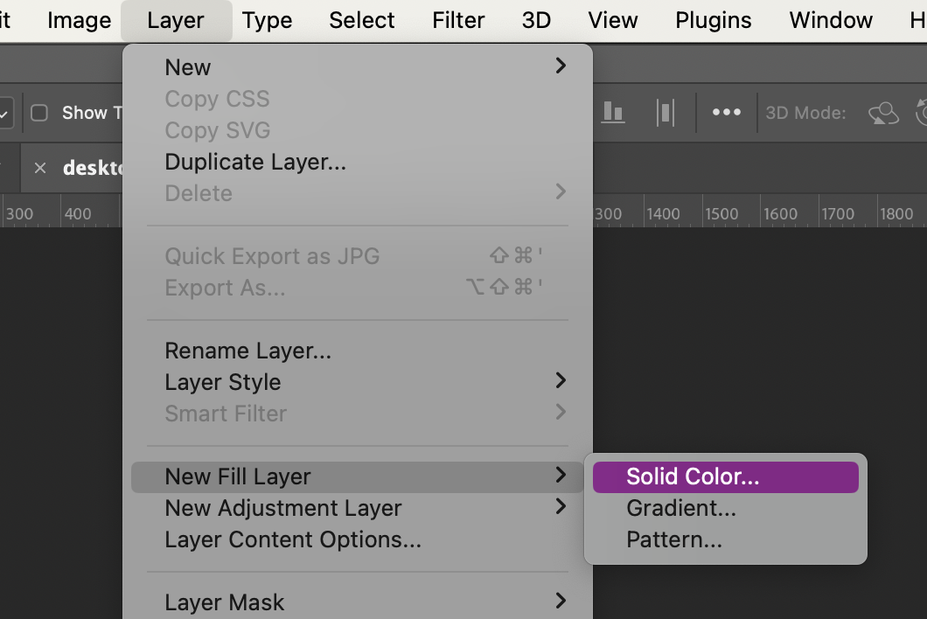
1. The set up
Start with desktop first
Open Photoshop file, either template, past file or start fresh with a new file
Remember to double check specs in the DPL, for this example we’re working with the full-width banner
Either create a new solid color fill layer with #faf8f2 or verify that is the background color

Slide 3
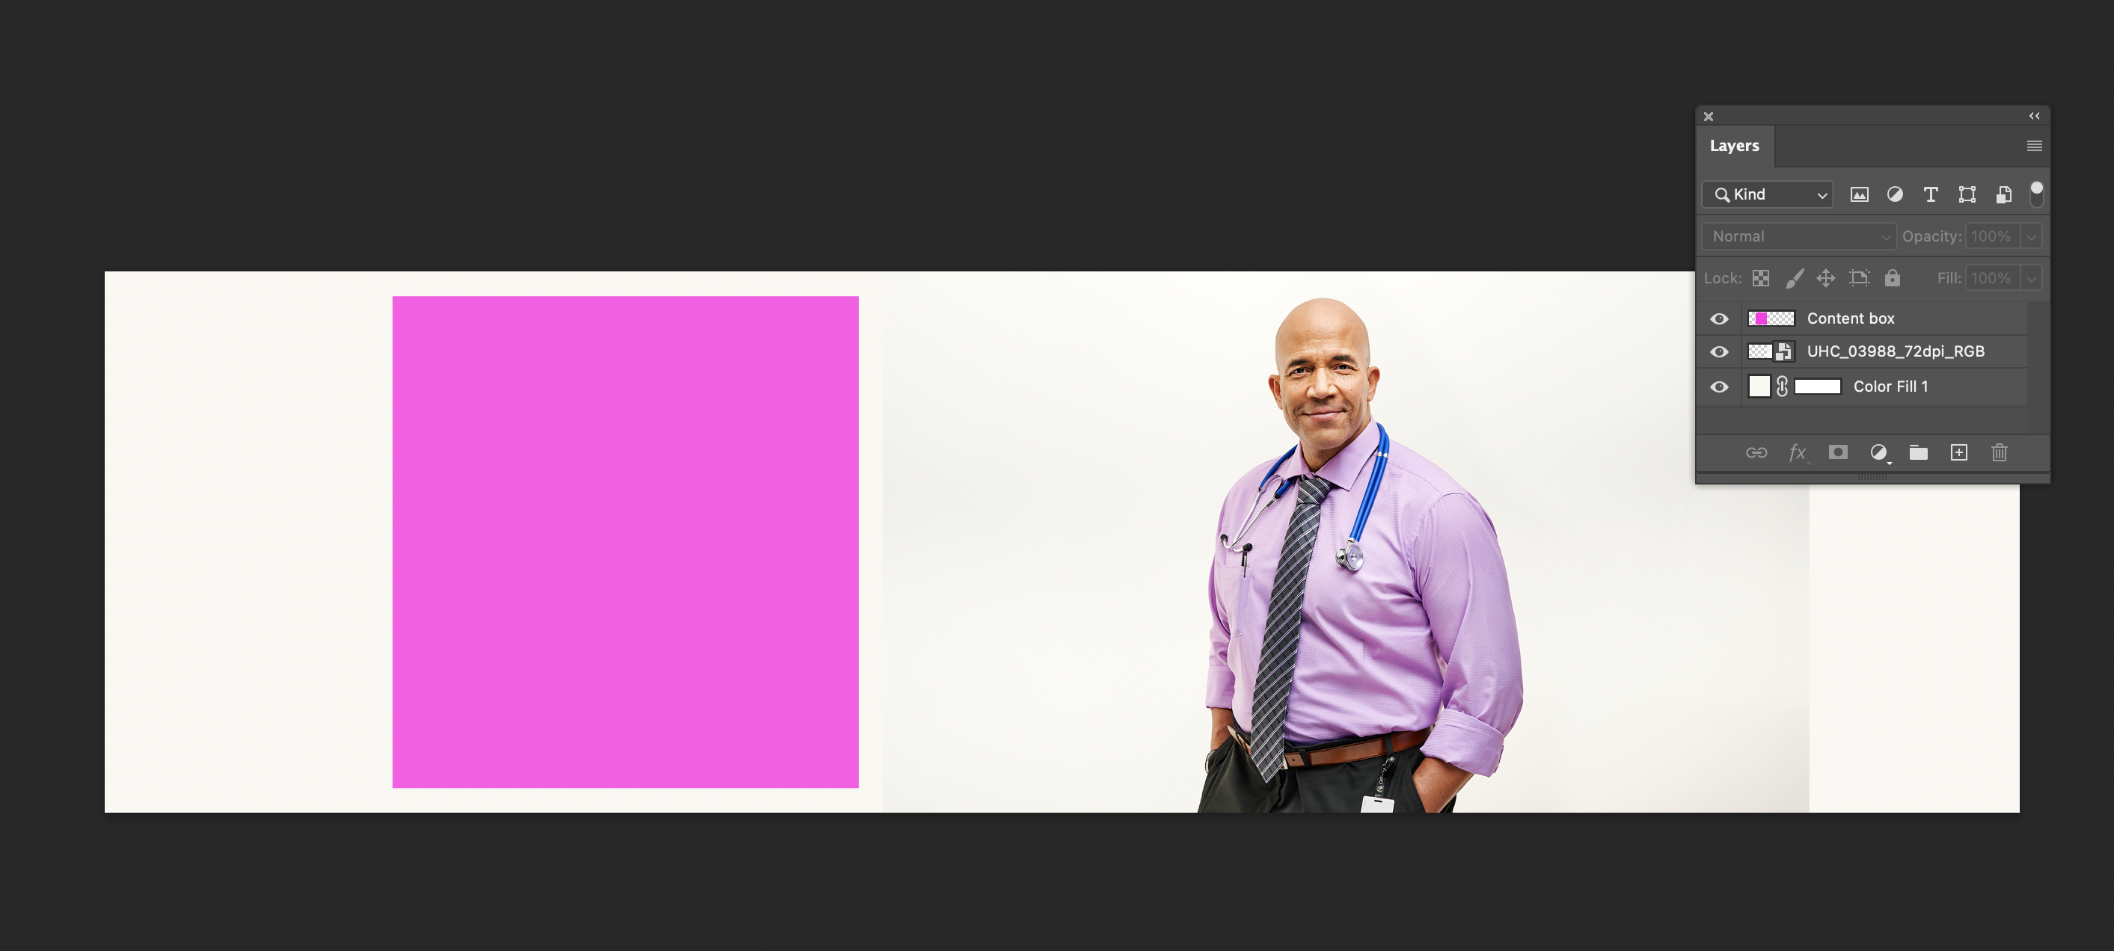
2. Place image
Place desired portrait image into Photoshop file
Use content box placeholder to help proportionally size image
Make sure to not have head too close to the top edge, as it may get cut off in larger desktops

Slide 4
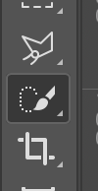
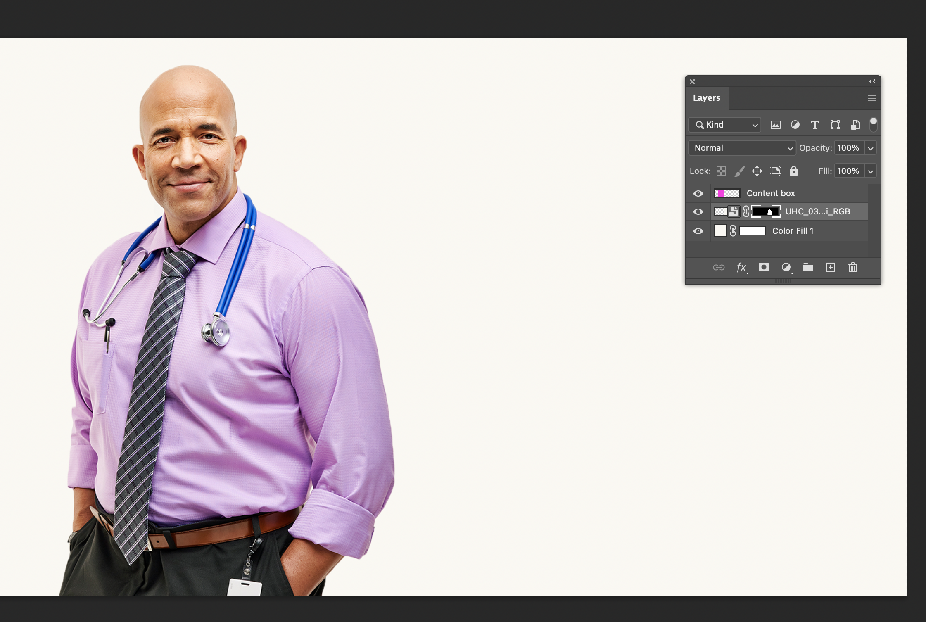
3. Mask image
Next, you’ll want to create a layer mask around the image to cut out the background
A layer mask will help retain the image quality
With the image selected use the quick selection tool to select the person in the portrait
And then in layers panel click “layer mask” and you’ll see a new linked silhouette on the image and the background of the image should disappear
Quick select tool
Layer mask tools

Slide 5
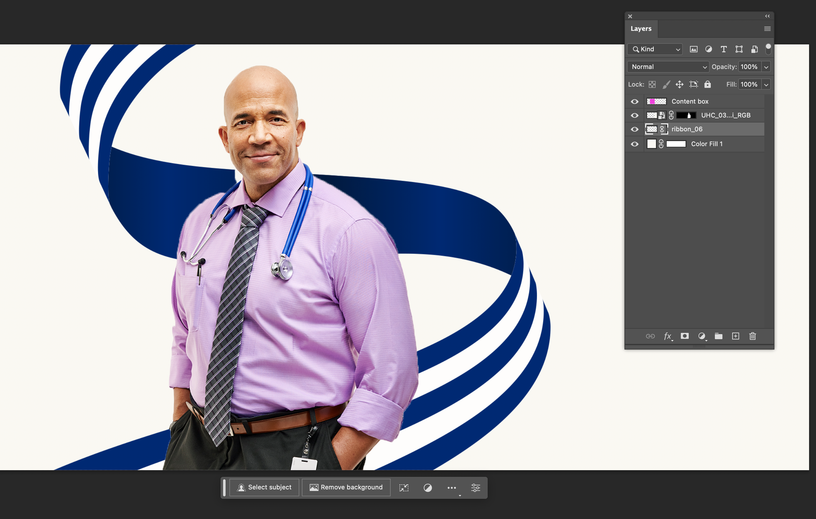
4. Place ribbon
Now you’ll choose one of the new ribbons from the “Custom Ribbon SVGs” folder and place it in the file – retain as a smart object
Ribbon should be proportional to the subject and overlap if possible but also allow for breathing room between ribbon and subject – for more guidance see brand central
Make sure ribbon is placed behind the portrait image in the layers panel
Now you’ll most likely see some imperfections we need to clean up in the next step

Slide 6
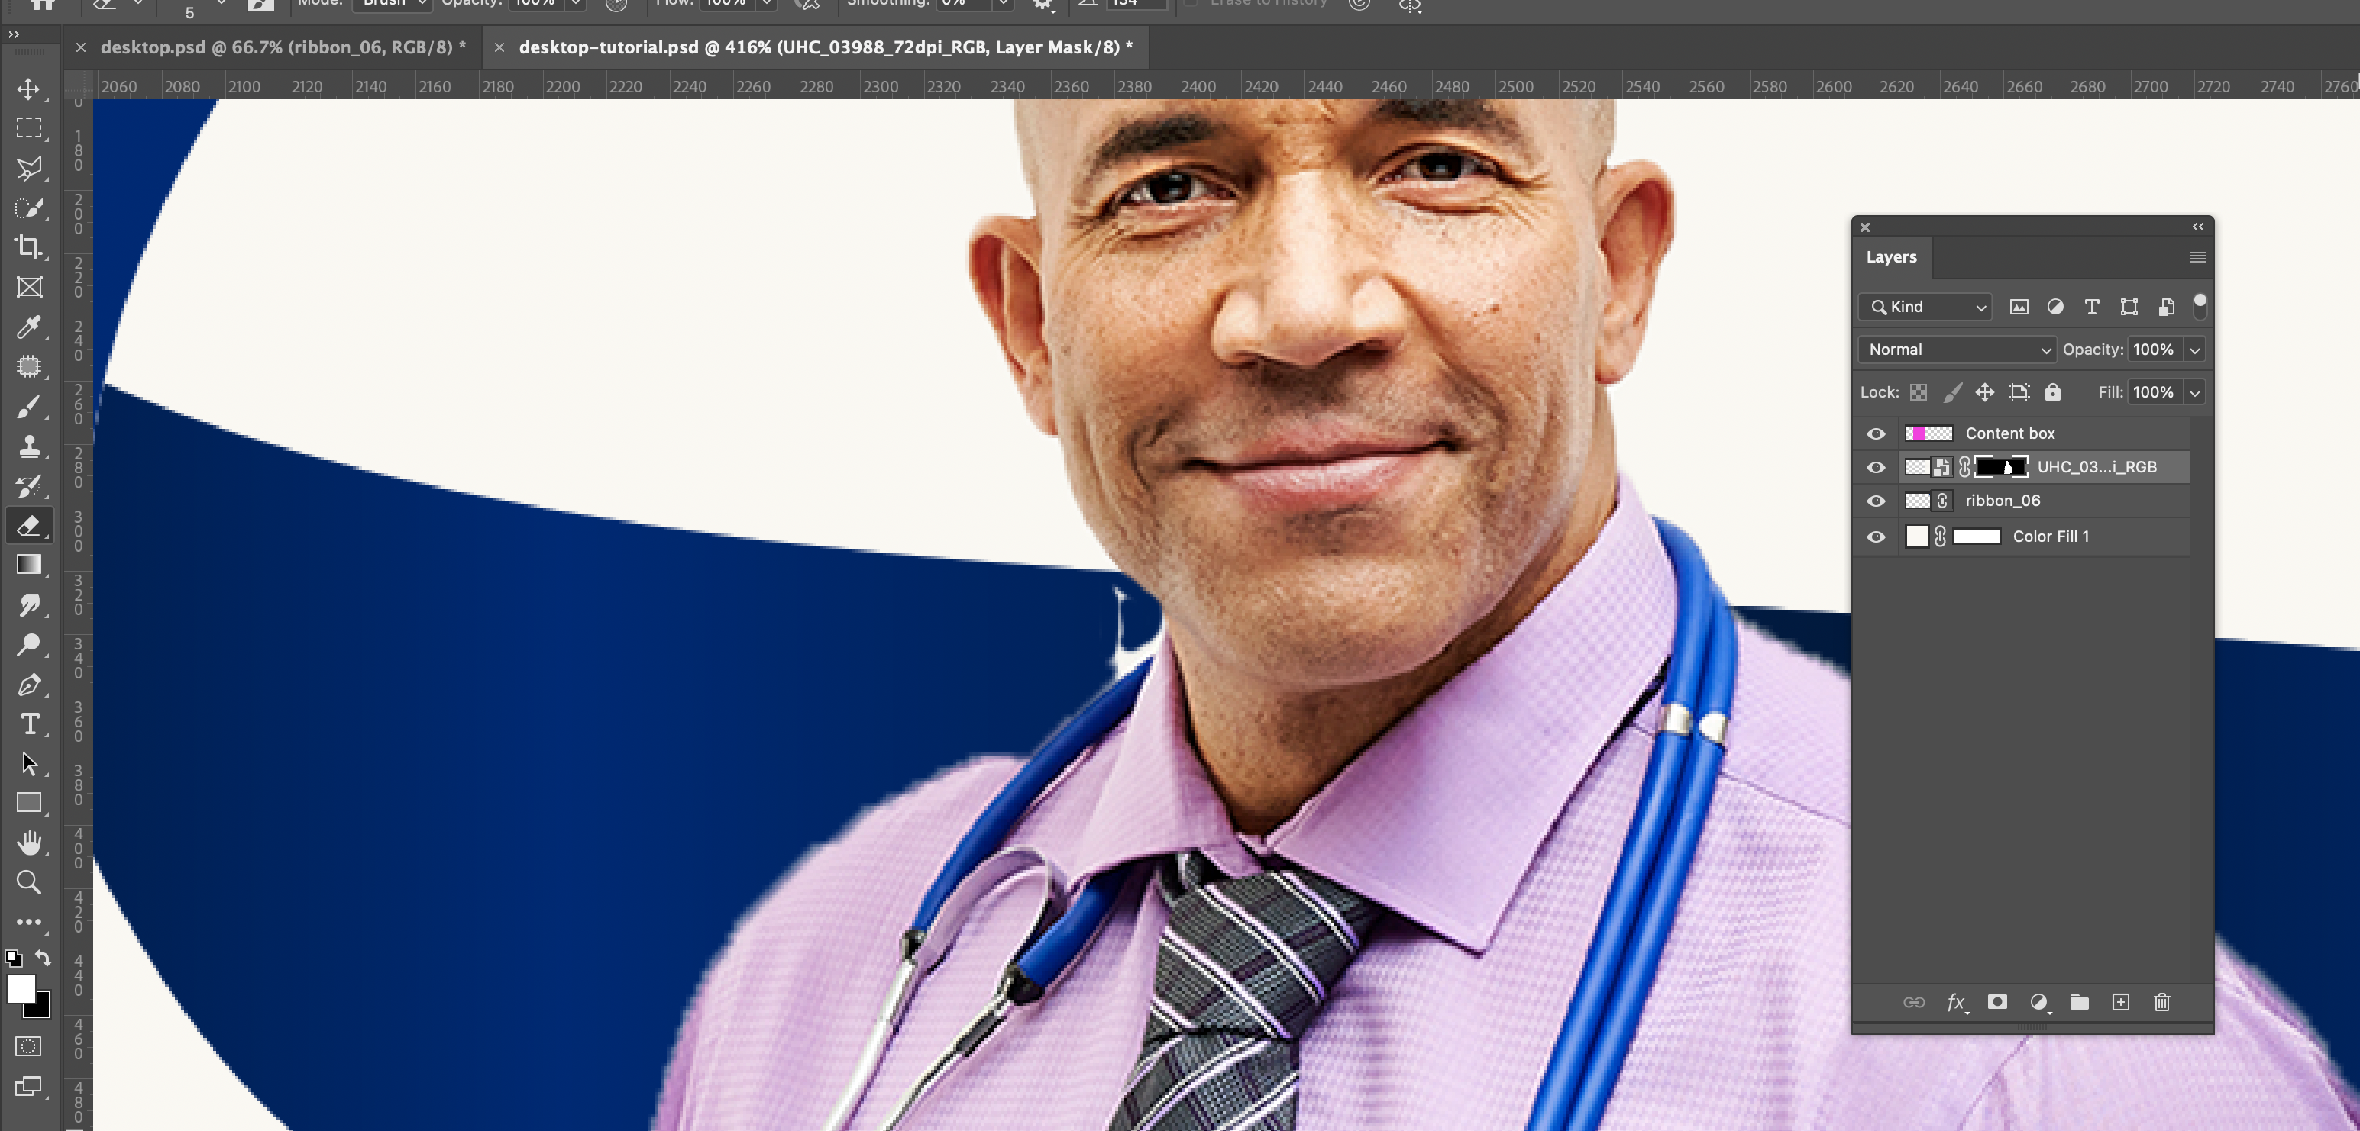
5. Clean up image layer mask
You’ll want to select the image layer mask and use the eraser tool to start to clean up that layer mask around the subject
Remember you can adjust your eraser size to get smaller or larger areas
Foreground colors are also important:
White = add to layer mask
Black = subtract from layer mask
Make sure this is selected
This is adding to the layer mask, meaning it’s revealing more of the ribbon and obscuring the portrait
If you had black as the foreground it would subtract from the layer mask showing more of the portrait. This is useful in case you erase too much of like his shirt or face and need to bring it back in

Slide 7
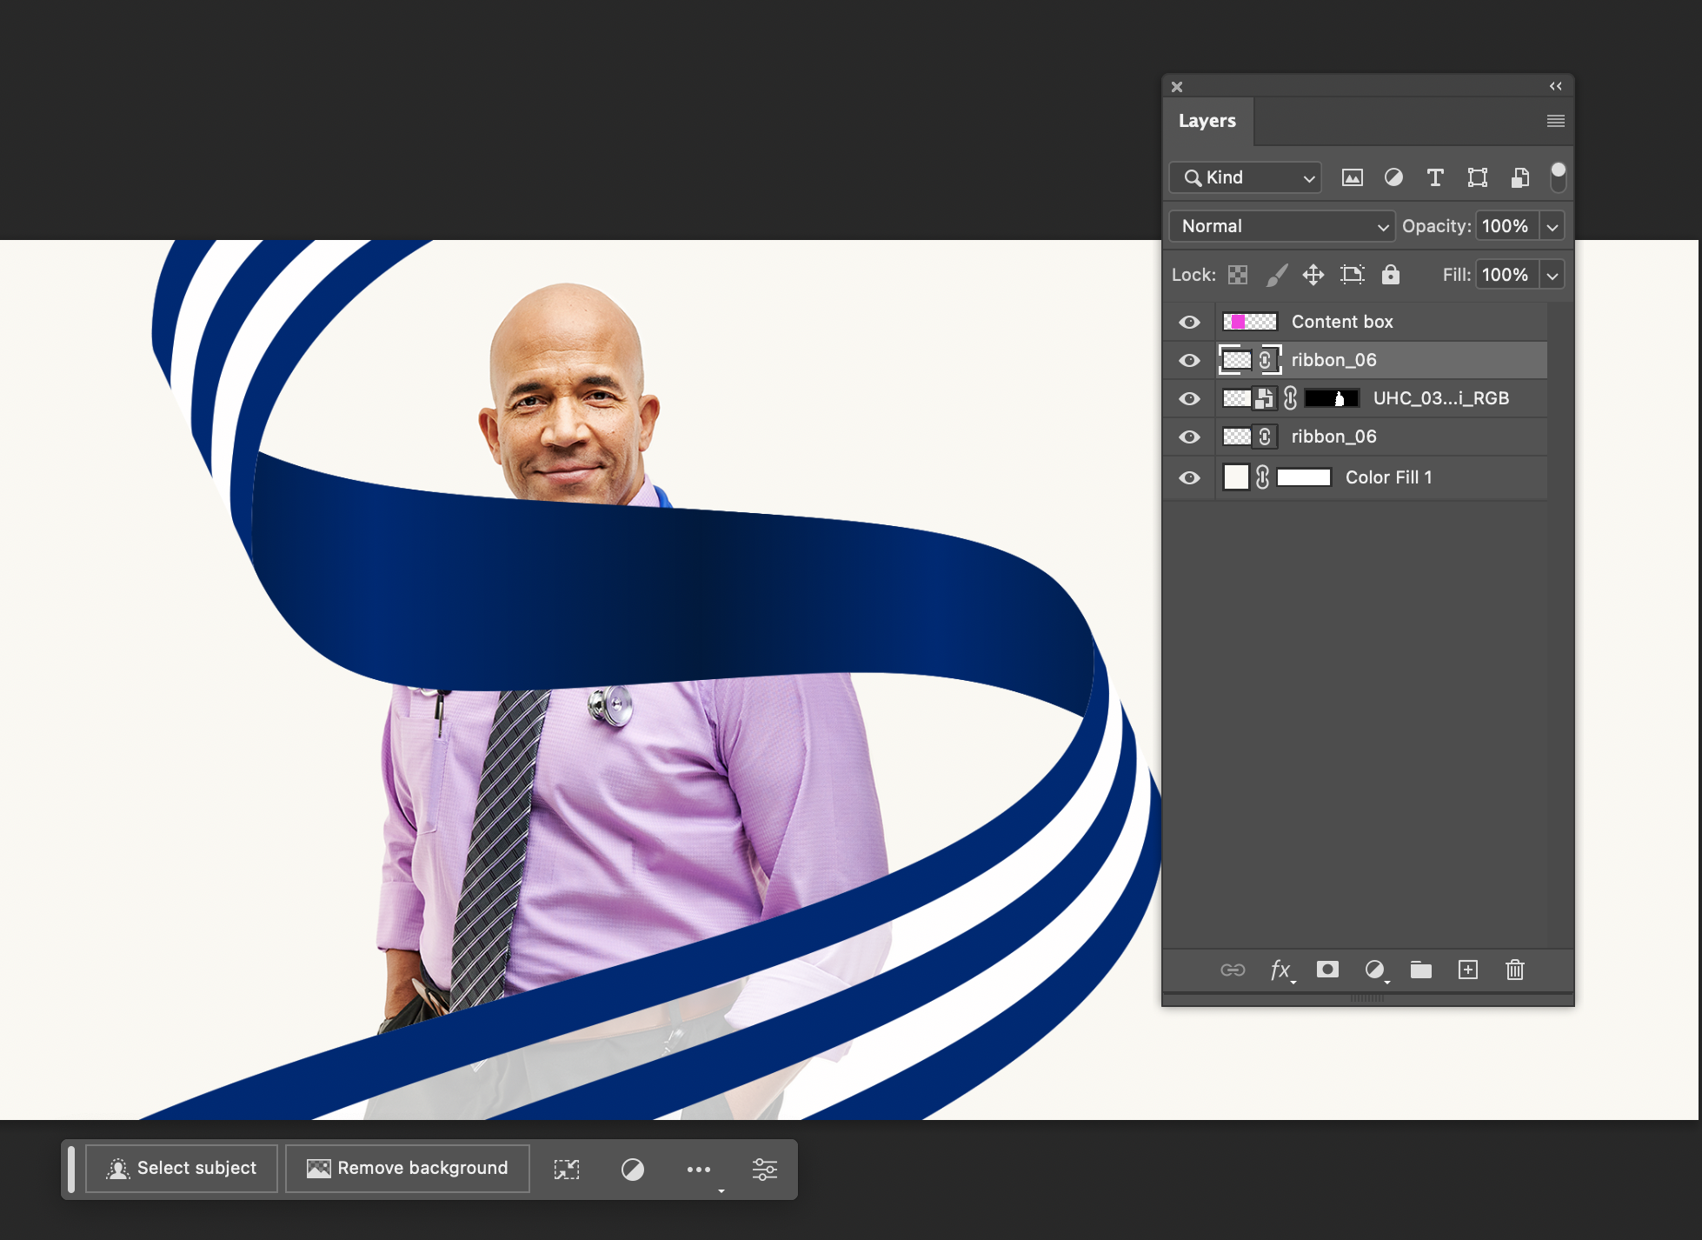
6. Setting up for the overlap
Now we’re going to tackle the part of the ribbon that will overlap in front of the subject
First select the ribbon and copy and paste special > paste in place
Make sure newly pasted ribbon is in front of the subject in the layers panel

Slide 8
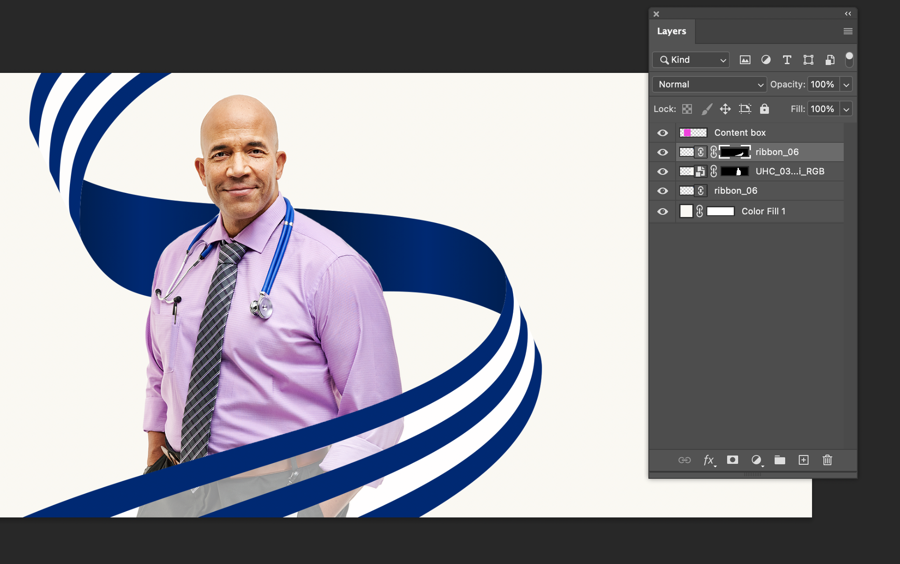
7. Mask the overlap
Like how we did this in step 4 we want to mask the portion of the ribbon that will be overlapping
With the new instance of the ribbon selected use the quick select tool to select the part of the ribbon that will overlap
Then select ‘layer mask’ in the bottom of the layers panel
Quick select tool
Layer mask tools

Slide 9
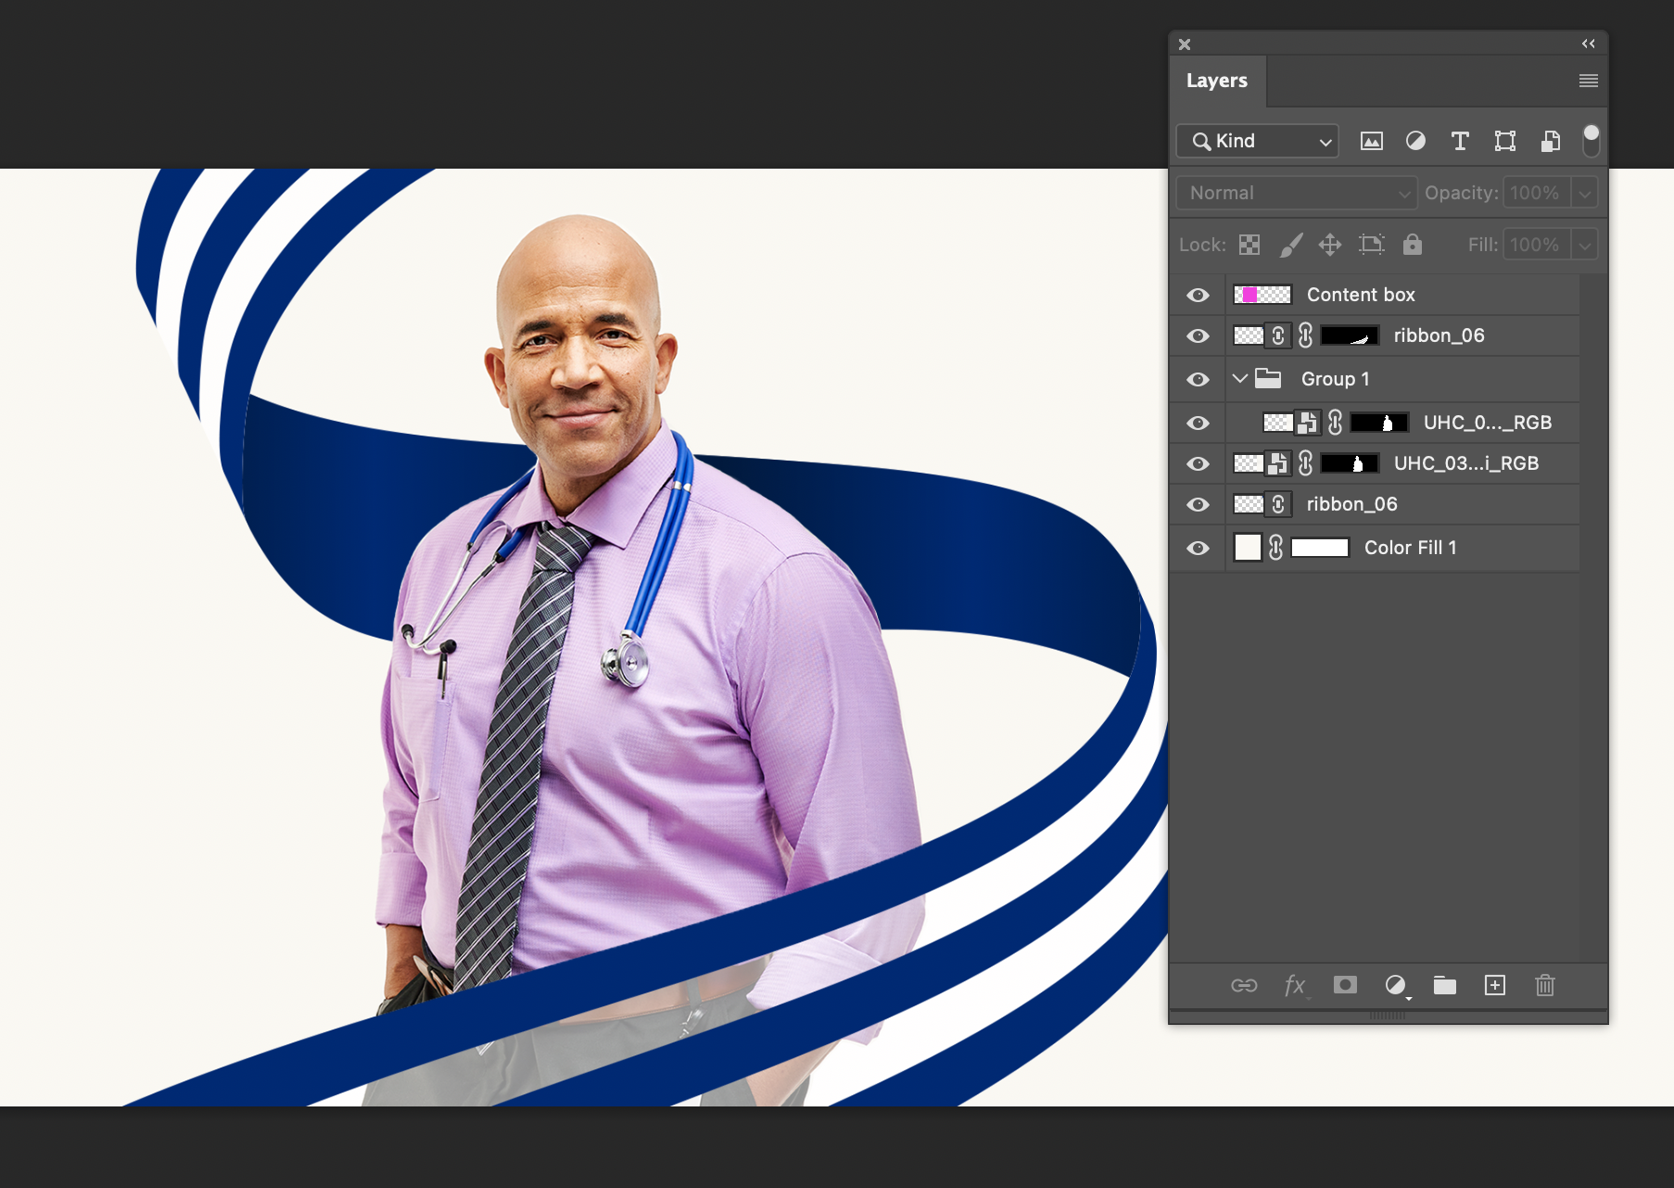
8. Adding depth
Now we need to target that area of the portrait image underneath where the overlap is occurring to add some shadow and depth
Copy and paste in place the portrait image and put it in a new group in the layers panel

Slide 10
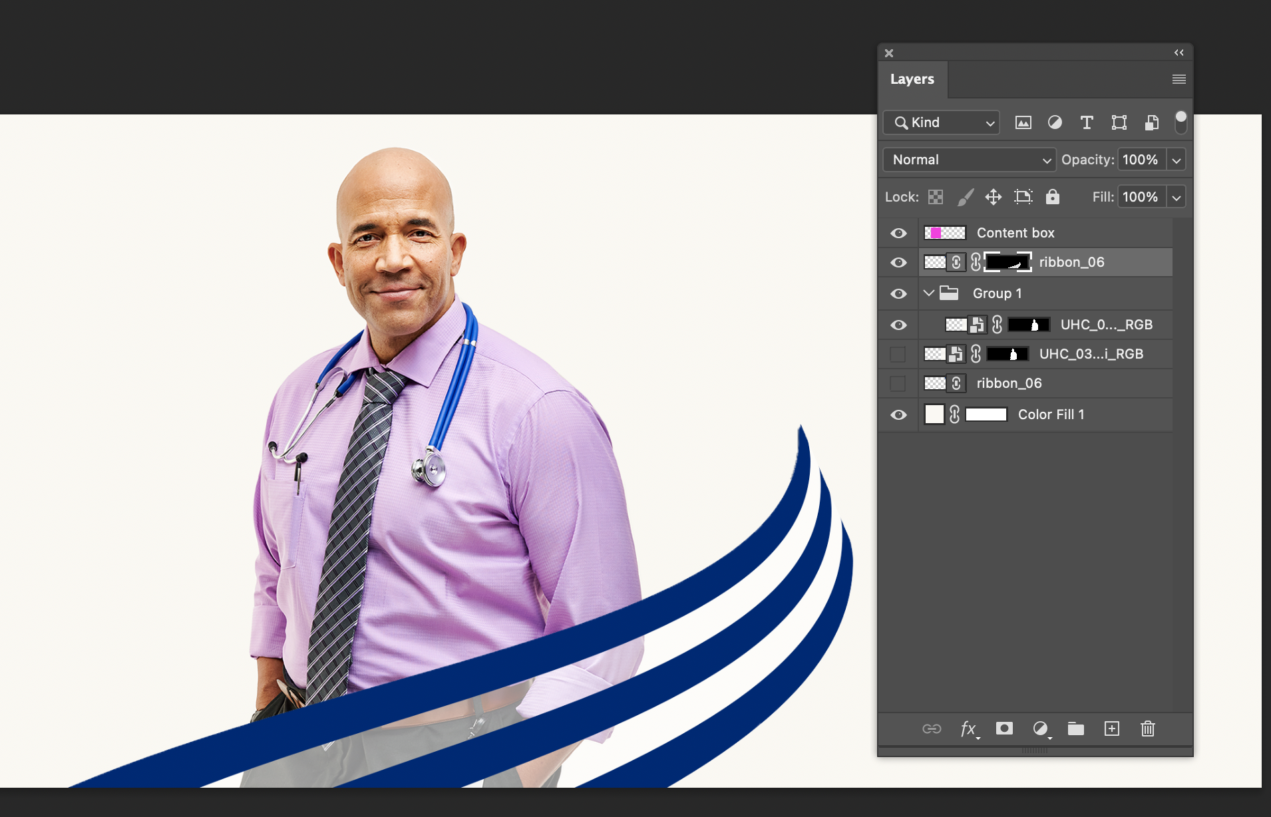
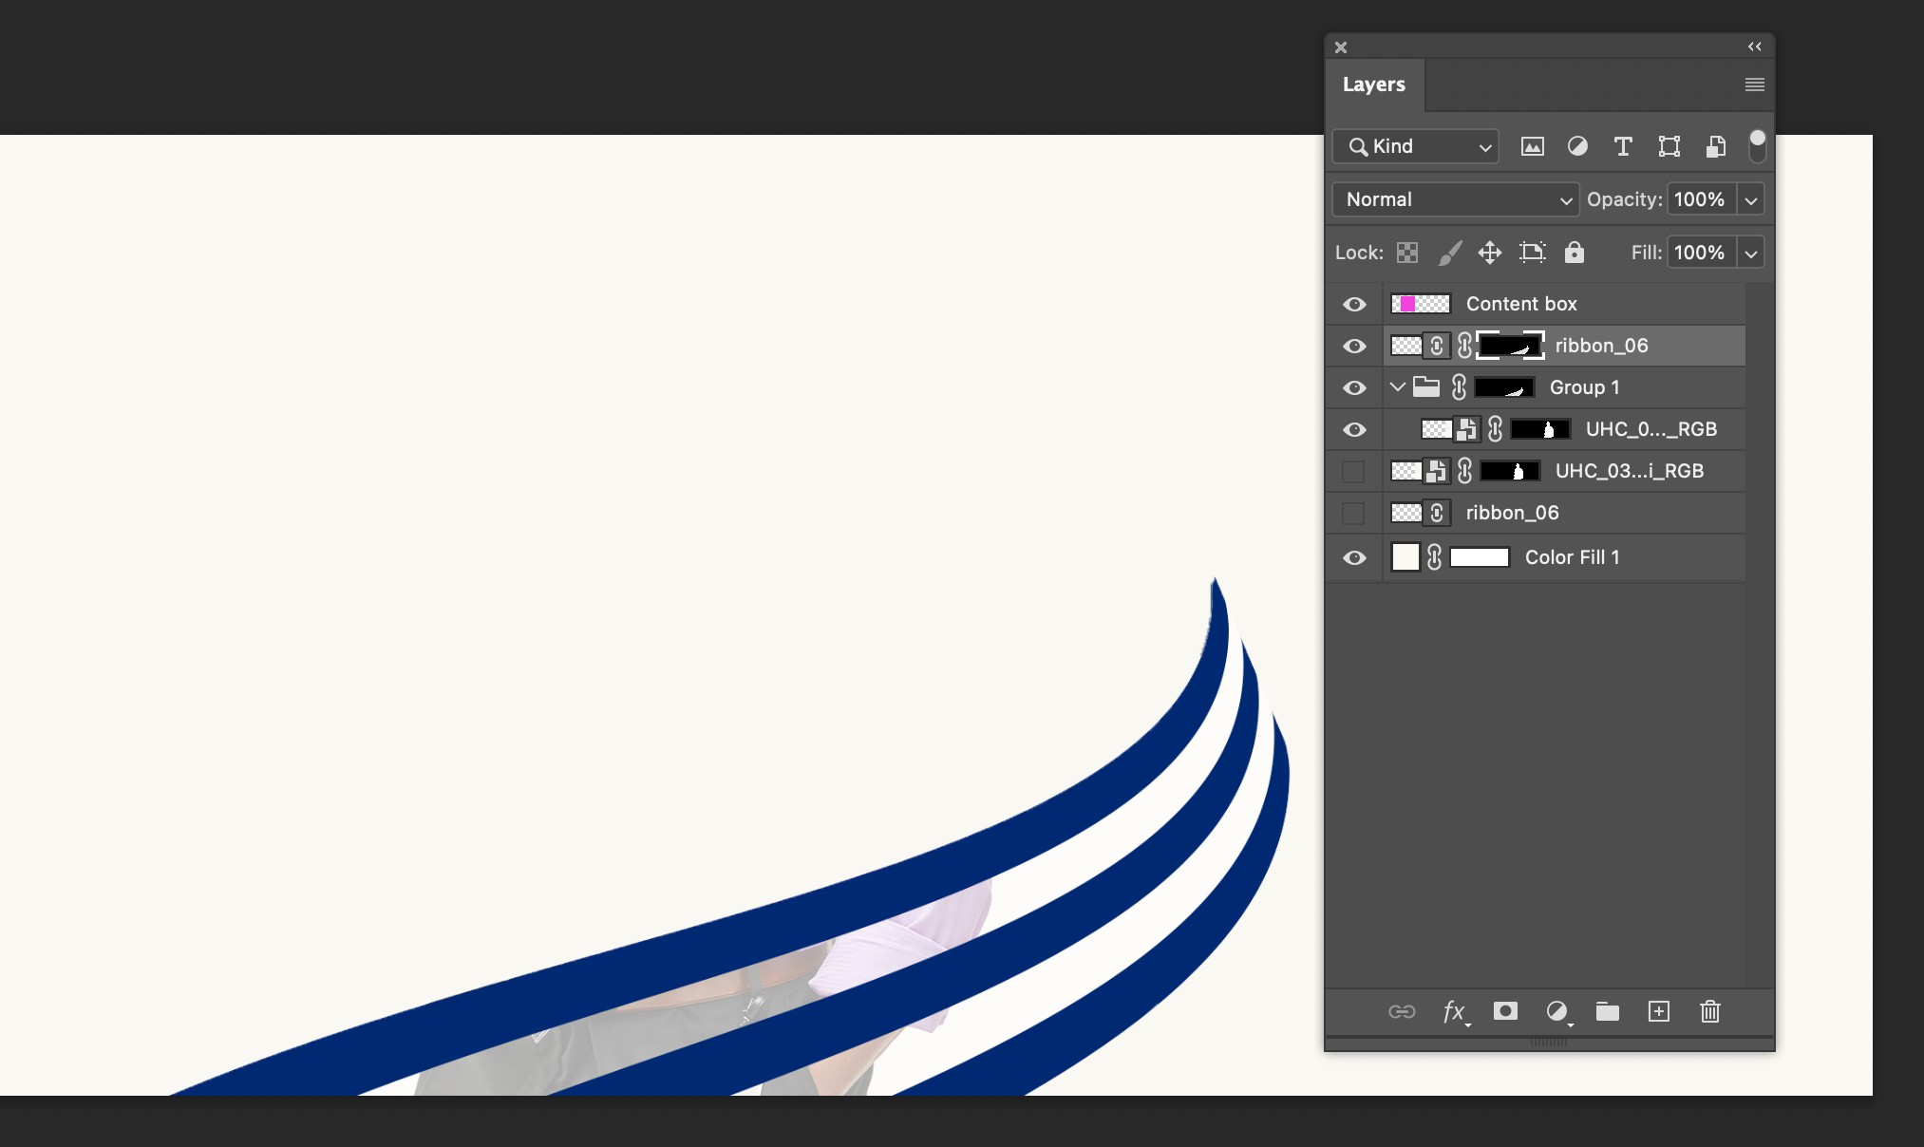
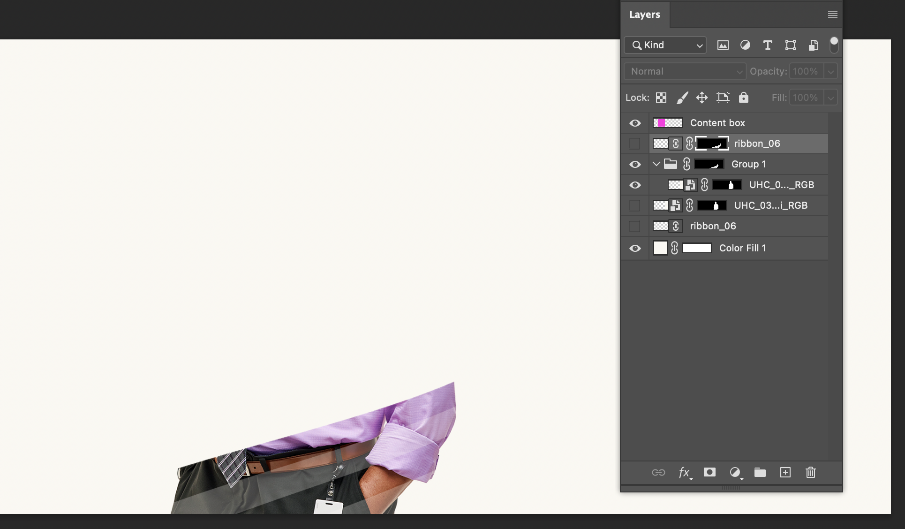
9. Adding depth (cont)
If you turn off the bottom layers you can see what we’re doing here
You want to basically copy this mask and apply into the group layer below it
Now select the layer mask of the top ribbon and while holding down ‘alt’ drag and drop a copy of that layer mask on to the group layer
What we’re trying to do is get that slice of image to be able to manipulate
Once you do that you can turn off that top layer ribbon to see that we’ve targeted that sliver of the image

Slide 11
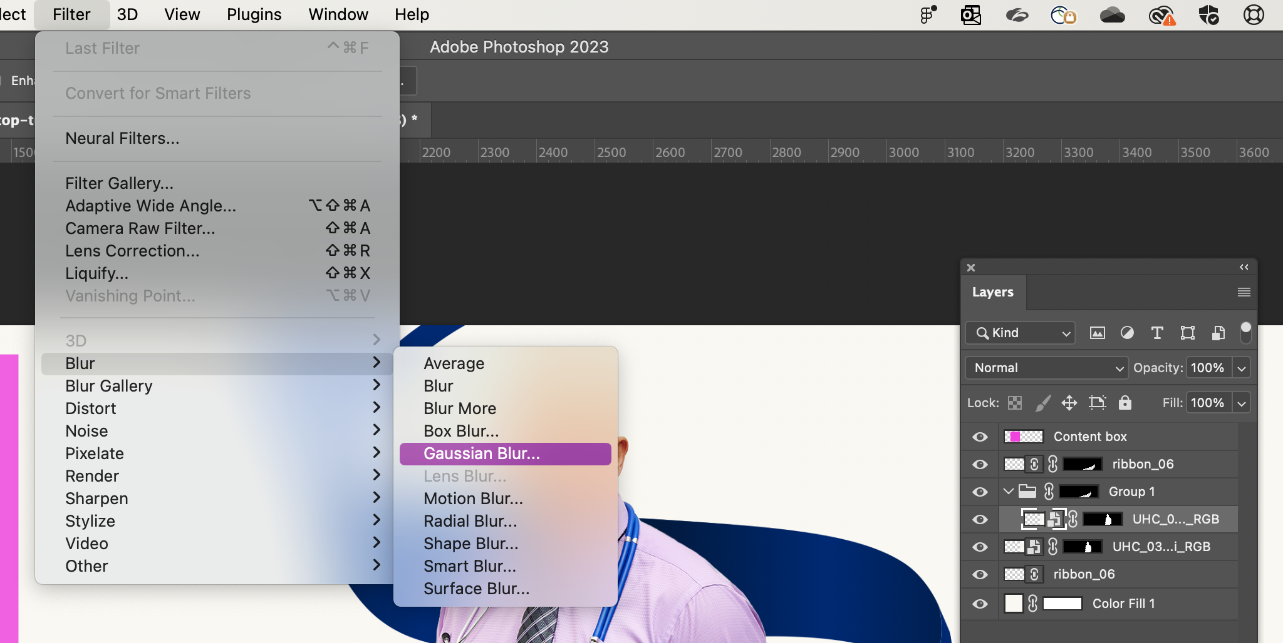
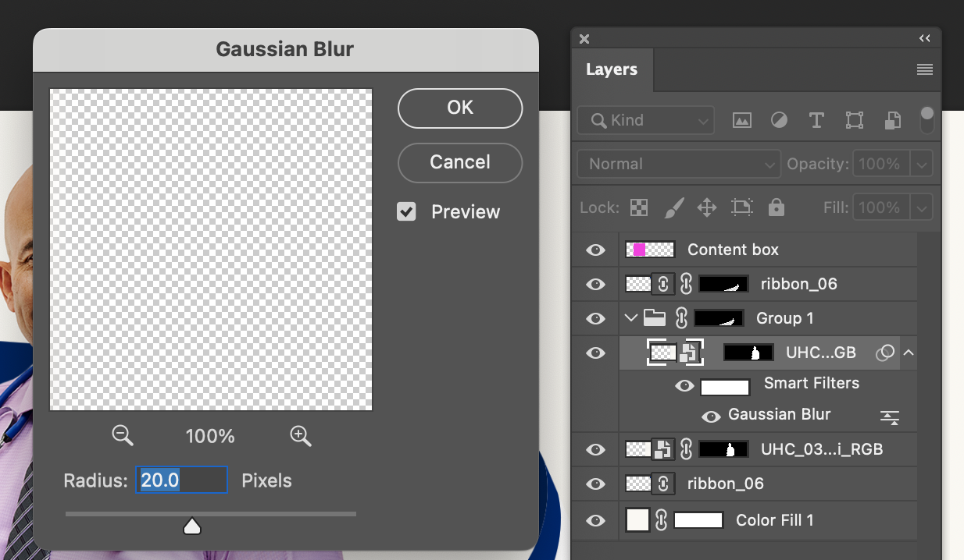
10. Adding depth (cont)
We can keep those other layers off to help make sure we’re seeing the changes we’re making
Select the image layer within the group
Go to Filter > Blur > Gaussian Blur
Add 20.0 Gaussian Blur

Slide 12
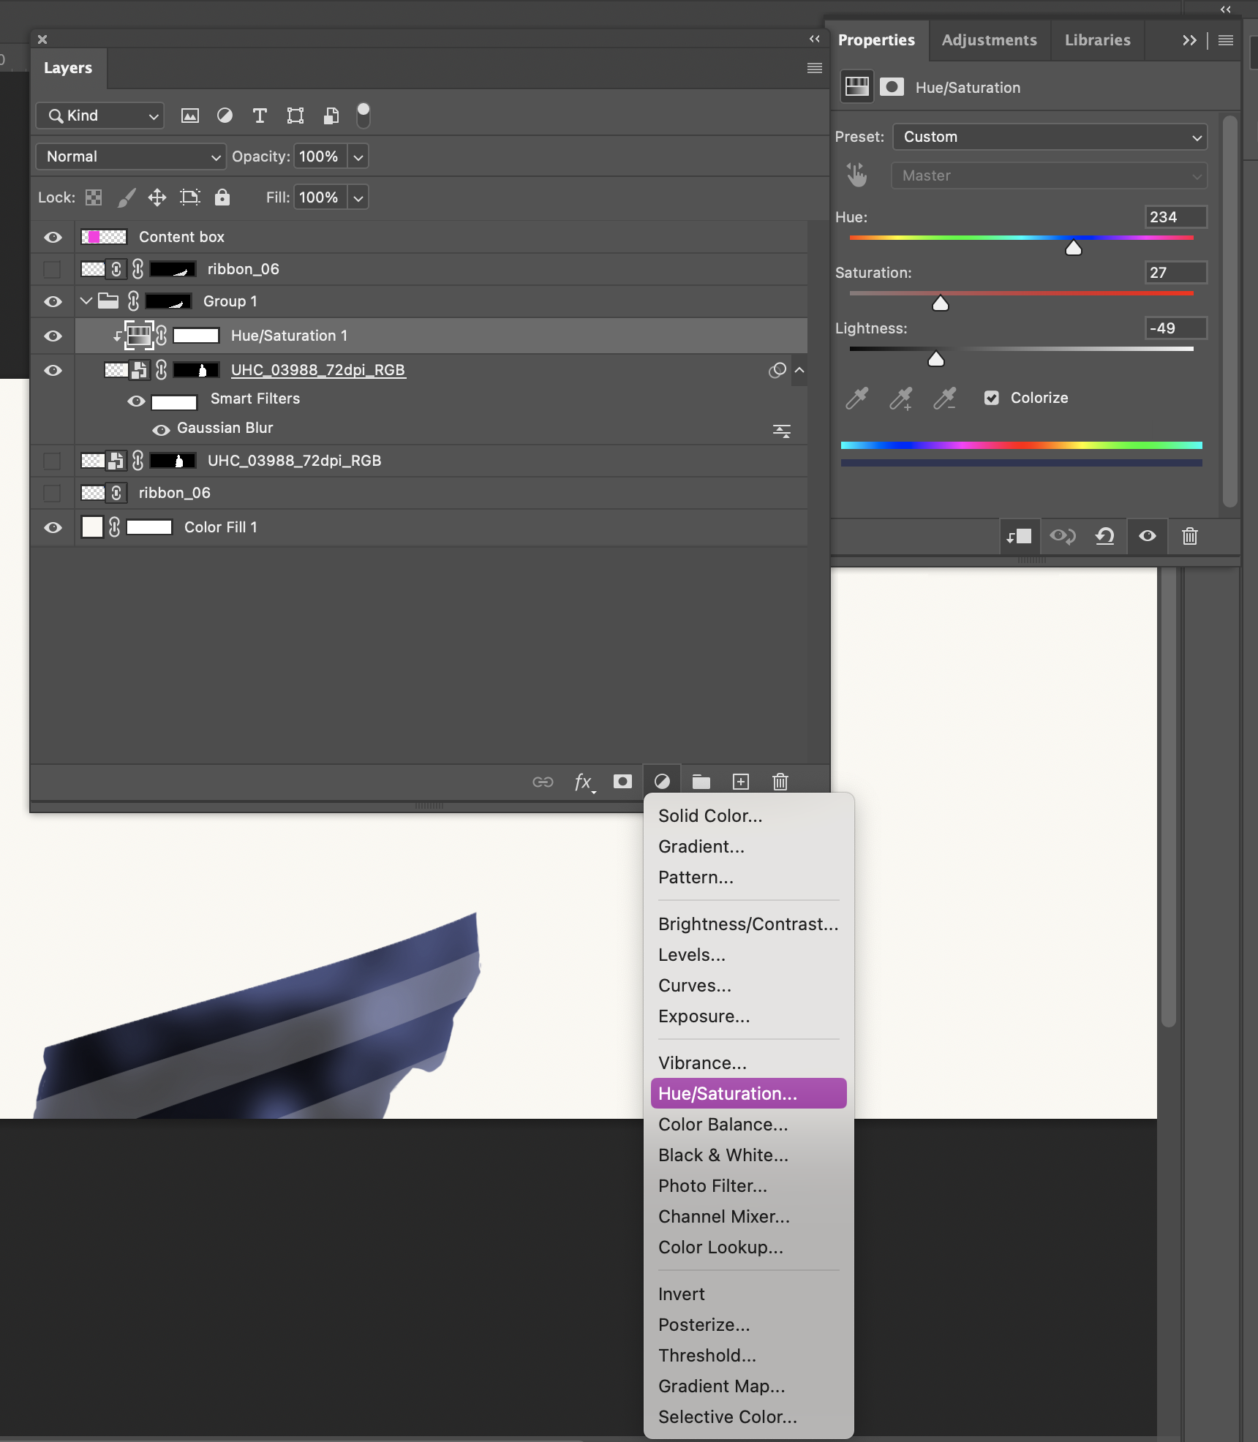
11. Adding depth (cont)
Add a Hue/Saturation layer effect to the group above the image layer
Hue: 234
Saturation: 27
Lightness: -49
This may be easier to copy from a past file, I have had issues getting the right numbers to work in Photoshop
Once you get it to work, right click the hue/saturation layer and select “create a clipping mask” so that it only applies to the layer below

Slide 13
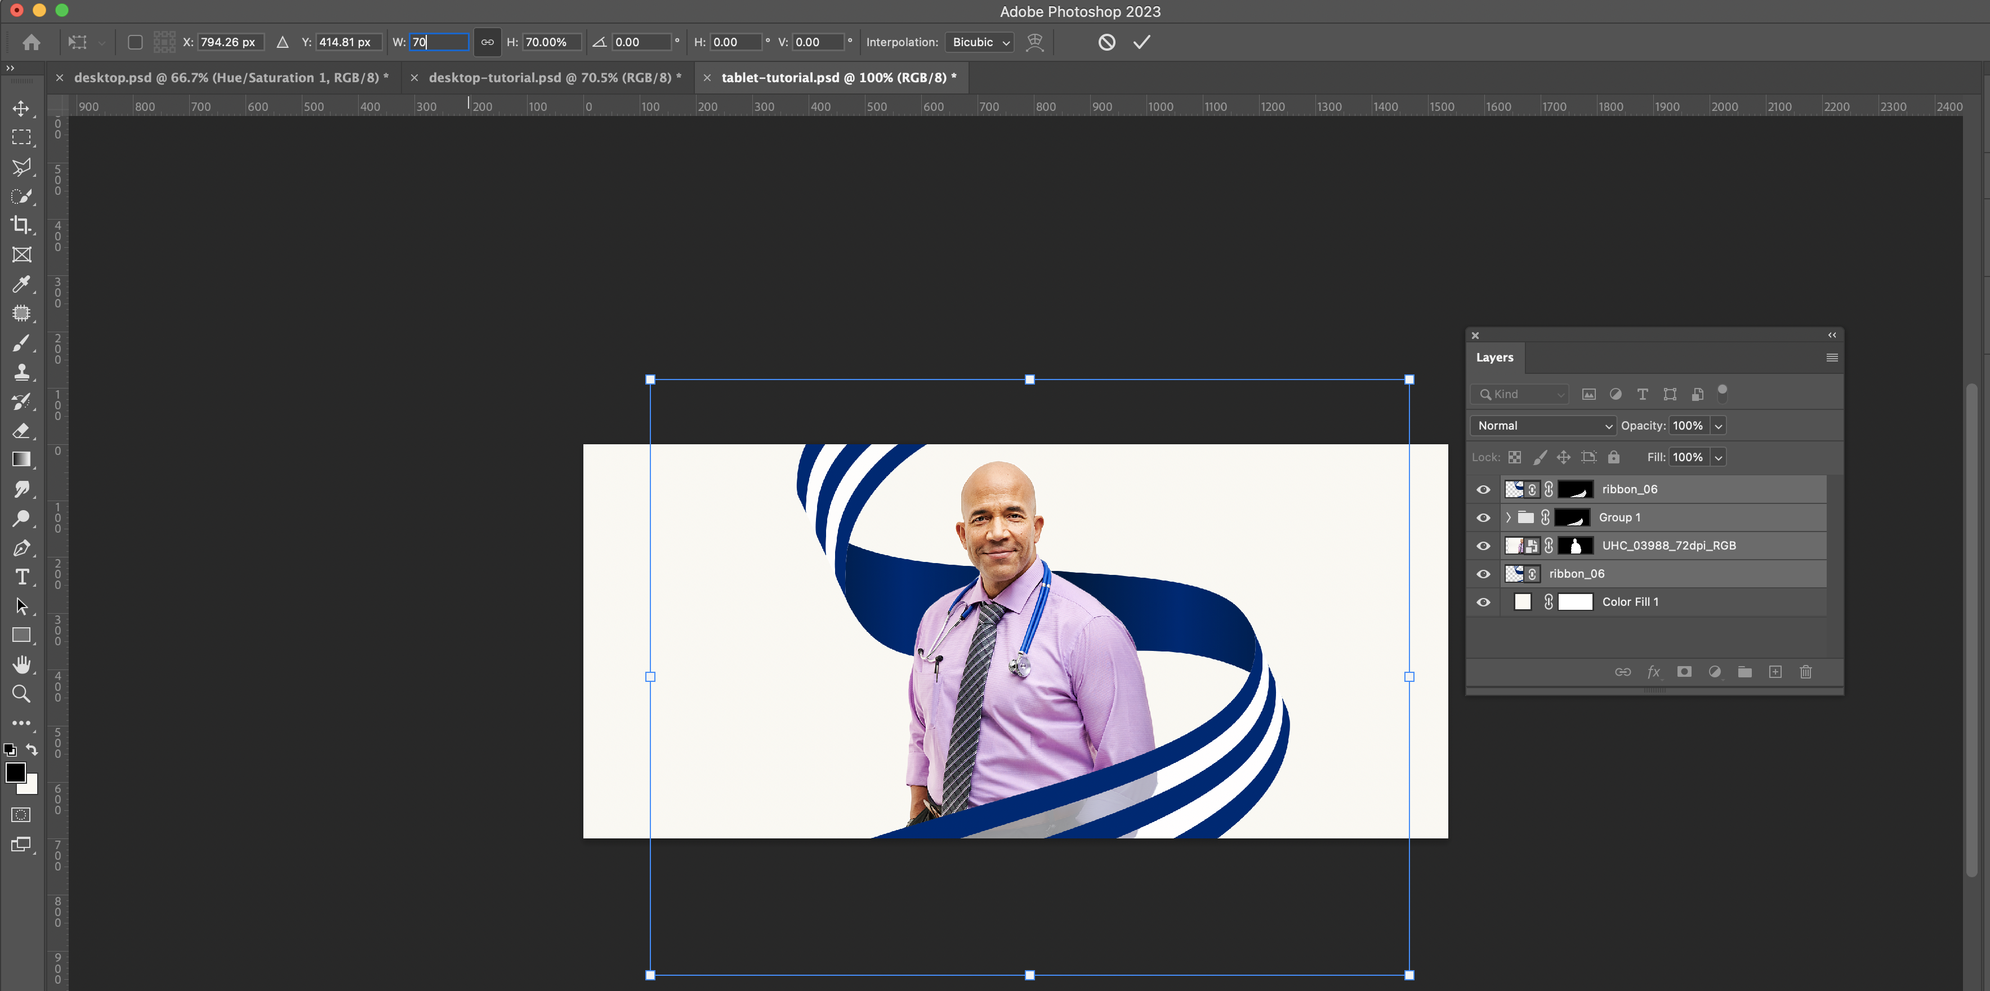
12. Wrapping up
Turn on all of the layers and here’s how you should be looking at this point
I have found it the easiest to then copy all the ribbon and image layers and paste it into tablet and re-size at about 60-75% and center
And then do the same with the tablet version and paste in mobile and re-size at about 60-75% and center
Make sure to not have ribbon close to left and right edges as they’ll get cut off in smaller devices – may need to re-size ribbon to be a little smaller than portrait

Slide 14
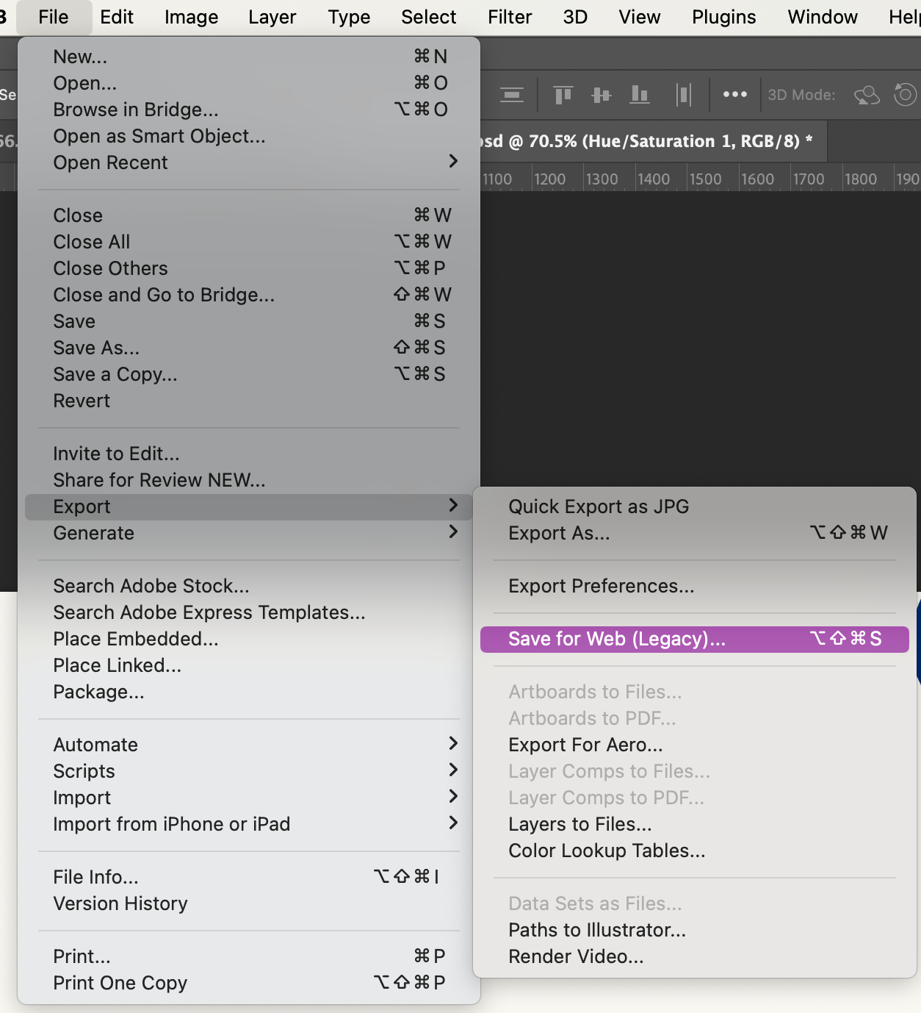
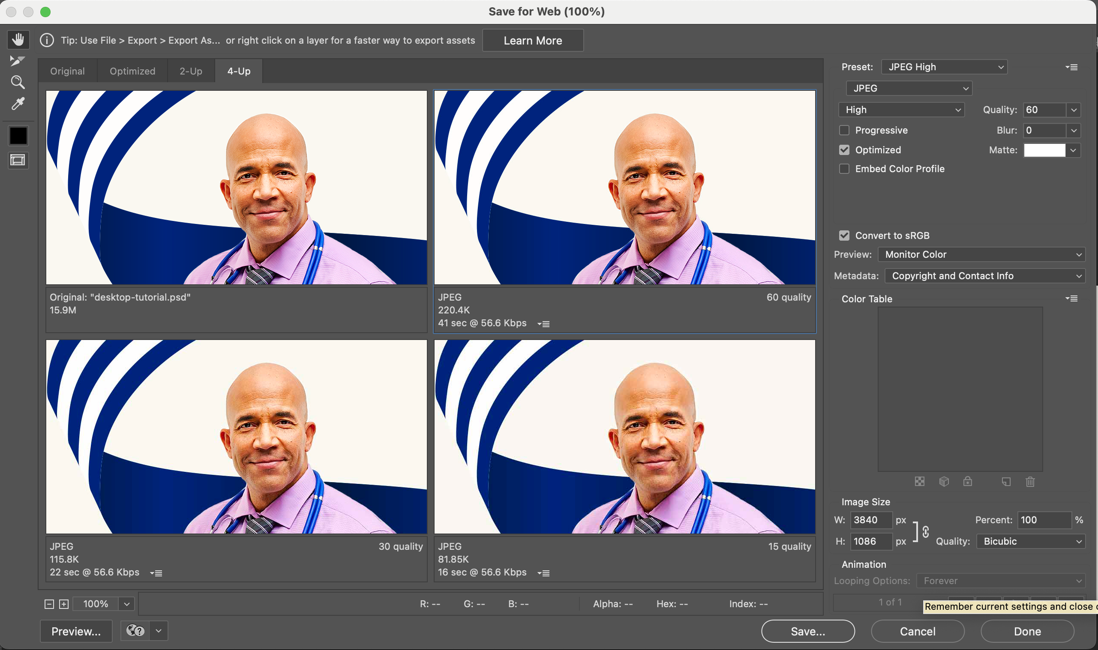
13. Exporting files
File > Export > Save for Web (Legacy)
Select JPEG
Select a quality that will result in images that are 350kb or less
File name examples
image-descriptor-size-mobile.jpg
empowering-dad-daughter-500x200.jpg
empowering-health-dad-daughter-500x100-mobile.jpg

