Slide 1
Smart icon how-to
uhc.com/dpl
2024

Slide 2
What is a smart icon?
Brand has 160+ icons with 4 different versions each, that’s 640+ files total.
To limit that many files in our system, uhc.com creates smart icons or SVGs that embed color classes for each icon variation that our code can turn on and off based on the styles an AEM author selects.
This means we only need to upload 1 file to get all 4 variations.
This how-to guide breaks down how to create those smart icons for AEM to use in our icon block component.

Slide 3
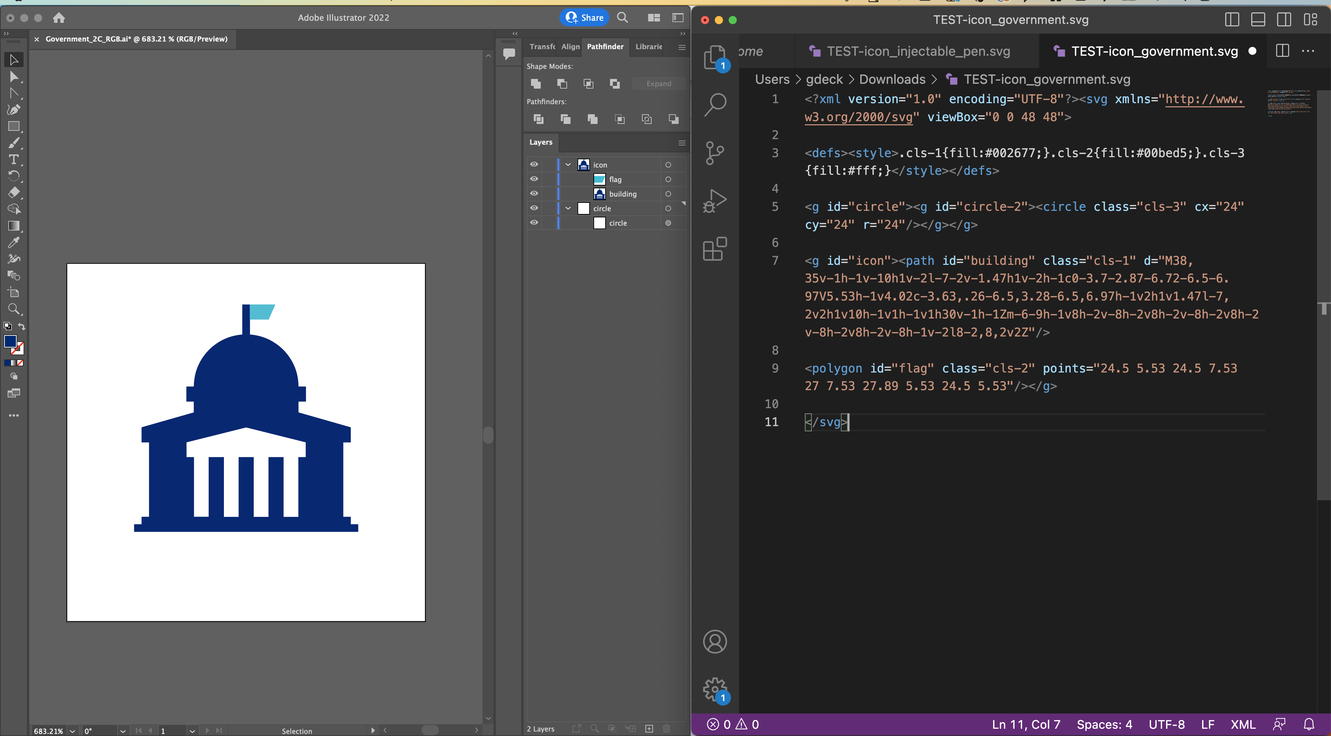
What is an SVG?
Scalable Vector Graphic
A coded vector image format - that for our use case of brand icons is holding the coordinates of the anchor points for all the shapes within our illustrator file.
EXPORTED SVG FILE
An SVG file can be opened in illustrator or in a code editor. For the purposes of smart icons, we’ll be manipulating the SVG in a code editor.

Slide 4
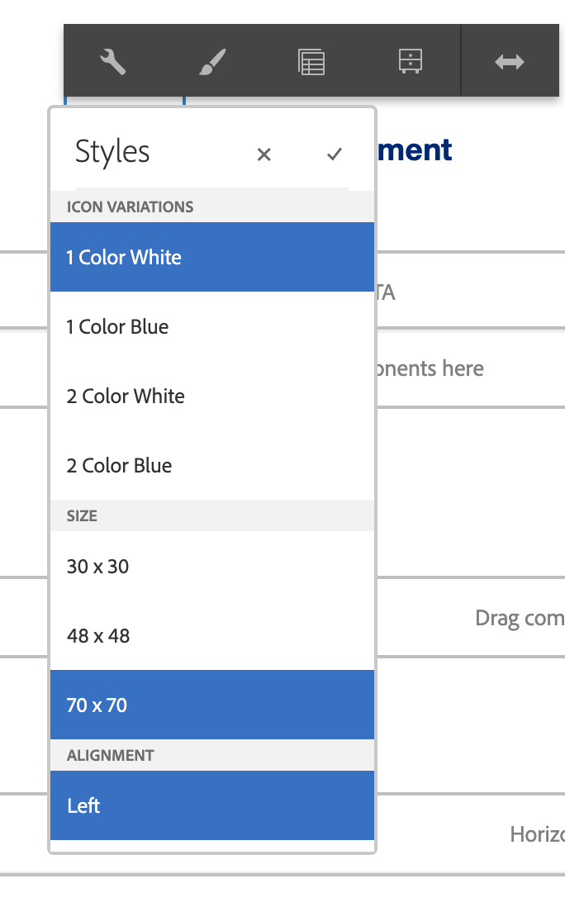
Icon ecosystem overview
BRAND ICON FILES – 4 VARIATIONS
AEM AUTHORING
(OT)
(OTC)
1-color w/ color background
(OTC)
1-color
(OT)
2-color w/ color background
(TTC)
2-color w/ white background
(TTCW)
(TTCW)
(TTC)
SVG CODE WITH CUSTOM COLOR CLASSES
0 = transparent, 1 = white, 2 = blue, 3 = bright blue

Slide 5
Overview
We’re going to prep our illustrator file to make sure that each icon has its shapes on individual and labeled layers.
Then we’re going to export that illustrator file to an SVG file.
We’re going to open that SVG file in a code editor (like Visual Studio Code) where we’ll remove the CSS classes that illustrator adds by default.
And then we’re going to add in our CSS classes from the parent stylesheet in AEM to each shape layer for every color it has for each icon variation.
And then we’ll upload and publish in AEM to be able to use in our icon block component.
What you’ll need
Adobe Illustrator
Code editor (like Visual studio code)
AEM DAM access

Slide 6
1. Prepare illustrator file

Slide 7
Evaluate all 4 variations to see if there are any structural differences between the set
With the exception that this will always be a compound shape on its own layer
No structural differences, all variations use the same shapes

Slide 8
Evaluate all 4 variations to see if there are any structural differences between the set
With the exception that this will always be a compound shape on its own layer
The one-color versions have an outlined shape for the mailbox flag vs. the two-color is a solid shape. We’ll need to take extra steps in preparing that illustrator file to build an all inclusive SVG file.

Slide 9
Prep illustrator file – no structural differences
I recommend using the 2-color white background illustrator file to create your SVG file.
It usually has all the shapes as individual layers; you’ll also want to copy in the otc compound shape from that illustration file, that’s almost like a cutout of the icon and paste it into this illustrator file to be able to export all possible shapes at once.
I recommend labeling your layers, because that will pull through in the SVG code and help you identify what shapes need what colors in the different versions.

Slide 10
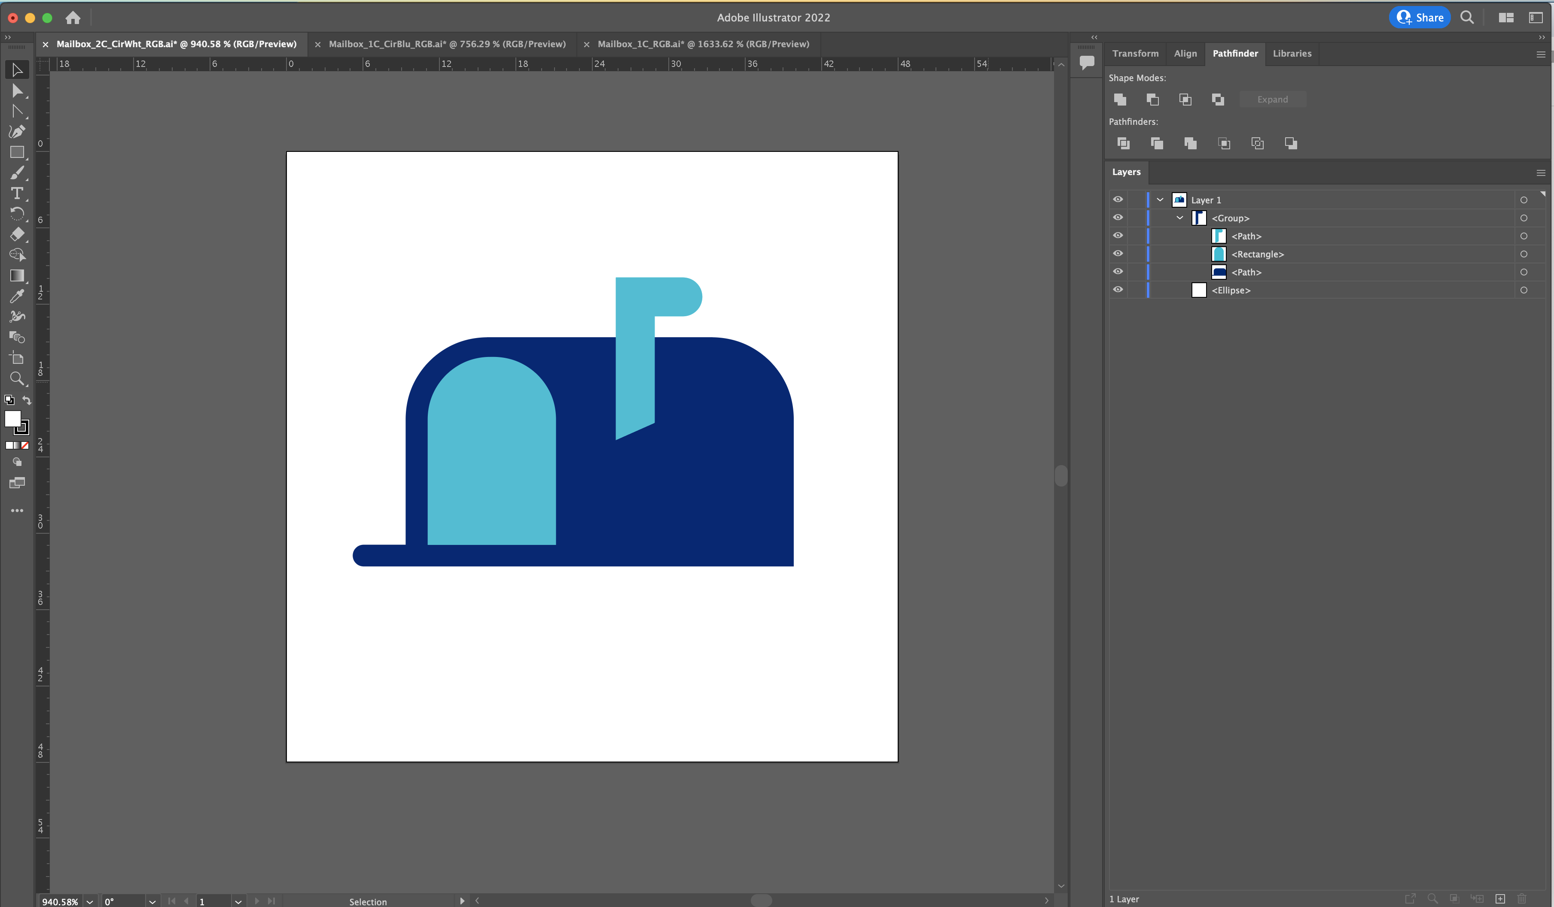
Prep illustrator file – structural differences
1. Open the 2-color white background illustrator file to create your SVG.

Slide 11
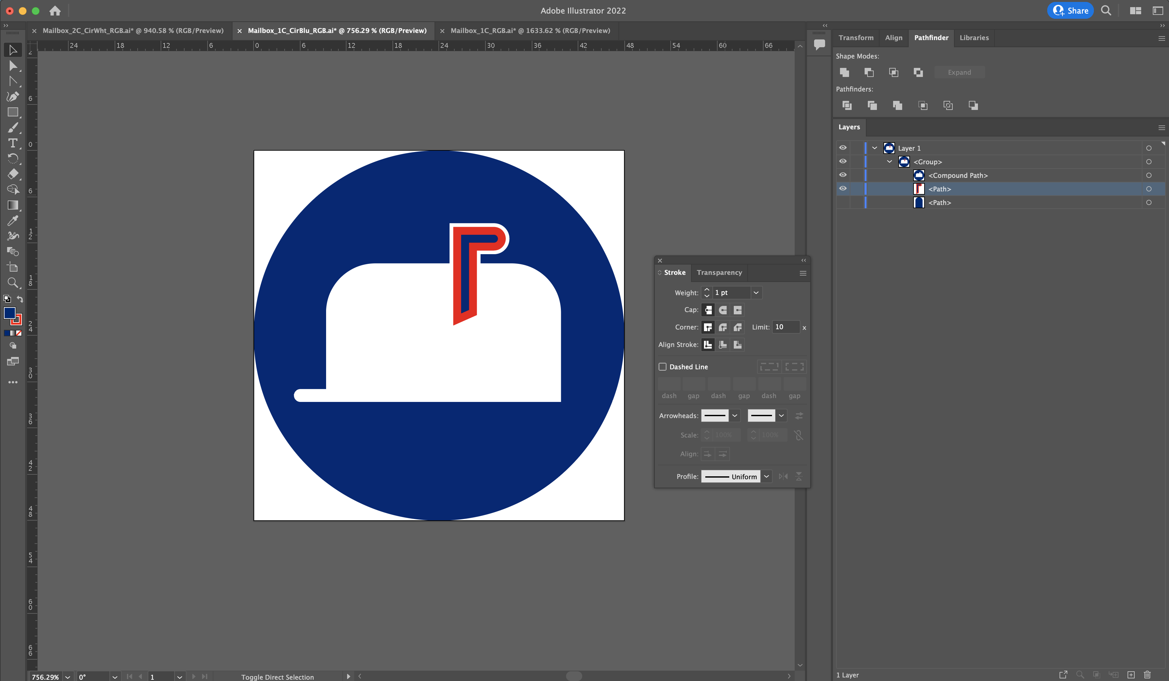
Prep illustrator file – structural differences
2. Also open the 1-color blue or white background illustrator file that has the outline style of the mailbox flag that we need.
You’ll likely have to re-create the shape or somehow target it in the compound path to be able to extract it.

Slide 12
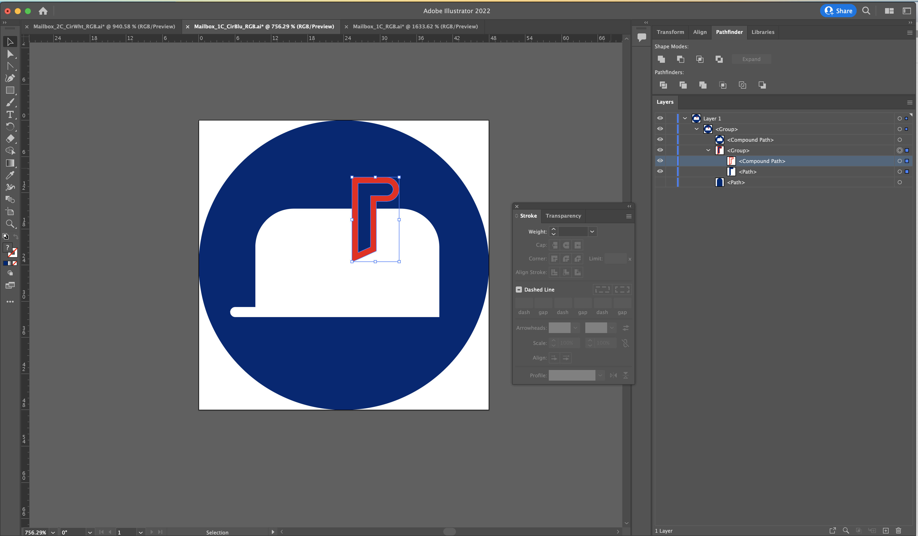
Prep illustrator file – structural differences
3. You will then need to ensure that the outlined mailbox flag is an actual shape and NOT a stroke.
Strokes do not show up in SVG code as individual shapes, and then can’t be targeted to change color classes and will also have issues scaling on screen.

Slide 13
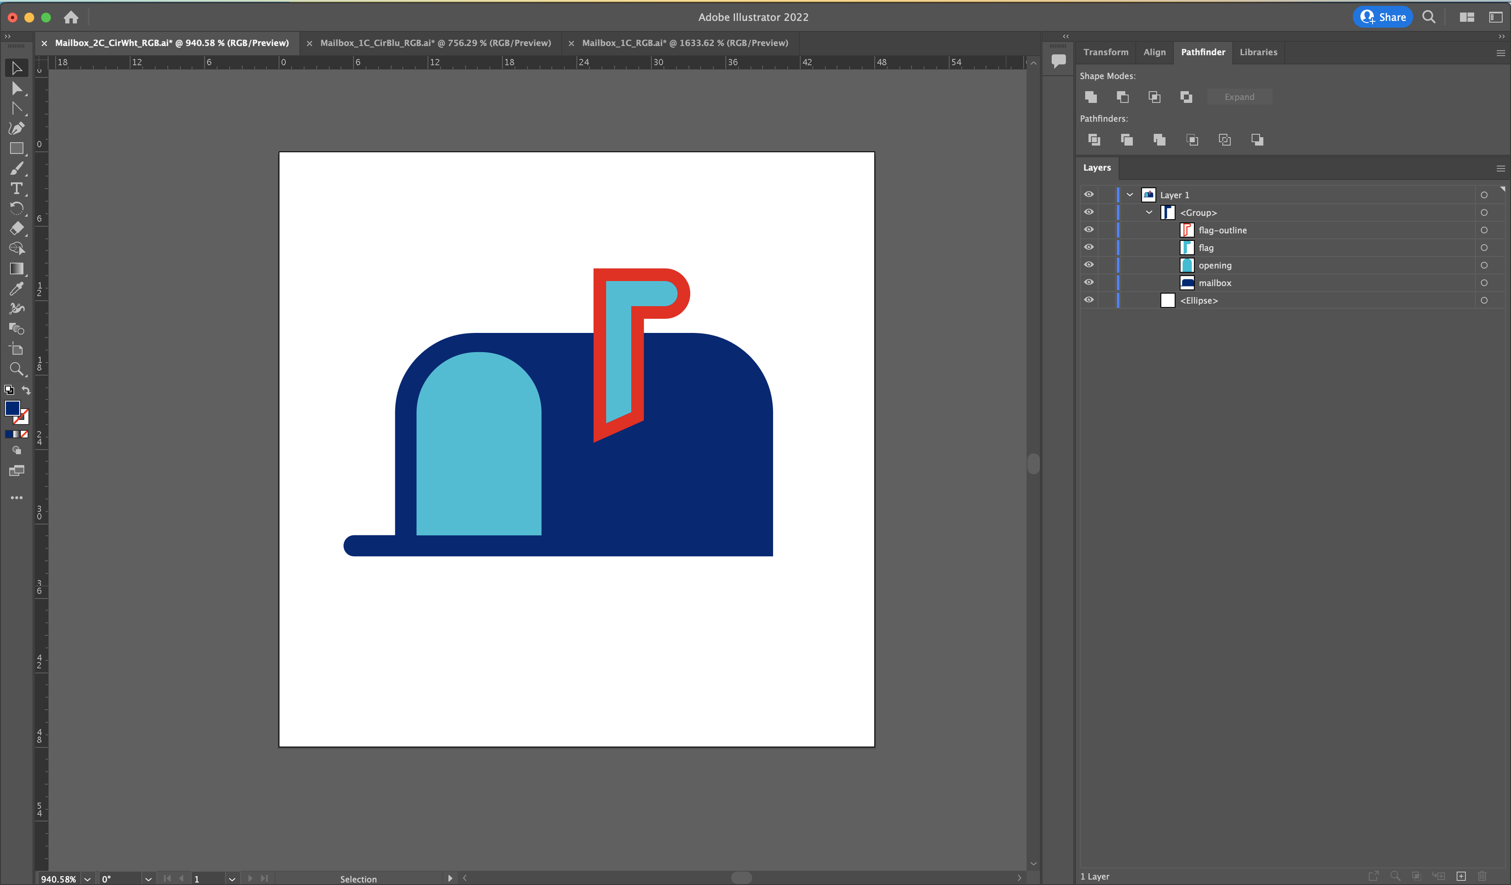
Prep illustrator file – structural differences
4. Now copy and paste that alternative version of the mailbox flag into the 2-color white background illustrator file
Label the layer in your layers panel and then you should be set up for this to show up in the SVG code to turn on and off as needed.

Slide 14
2. Export SVG

Slide 15
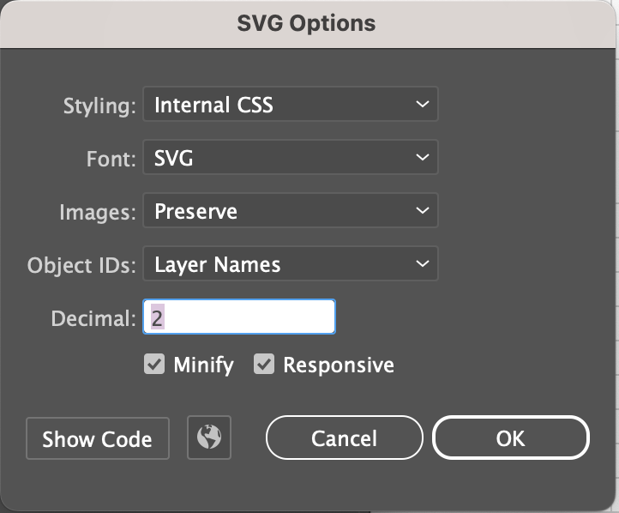
Export SVG from illustrator
File > Export as
Format = SVG
Click “Export”
Follow these SVG option settings
Click “Ok”

Slide 16
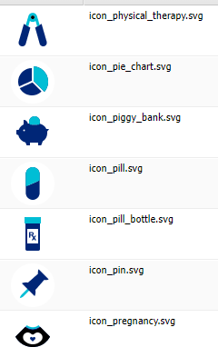
Naming convention
When exporting your svg from illustrator make sure to follow the naming convention:
icon_[object].svg

Slide 17
3. Clean up SVG code

Slide 18
Turn word wrap on view > word wrap
When you first open your SVG file in a code editor, it’s going to look like one chaotic line, and you’ll want to turn word wrap on. Most code editors have it under the “view” menu.

Slide 19
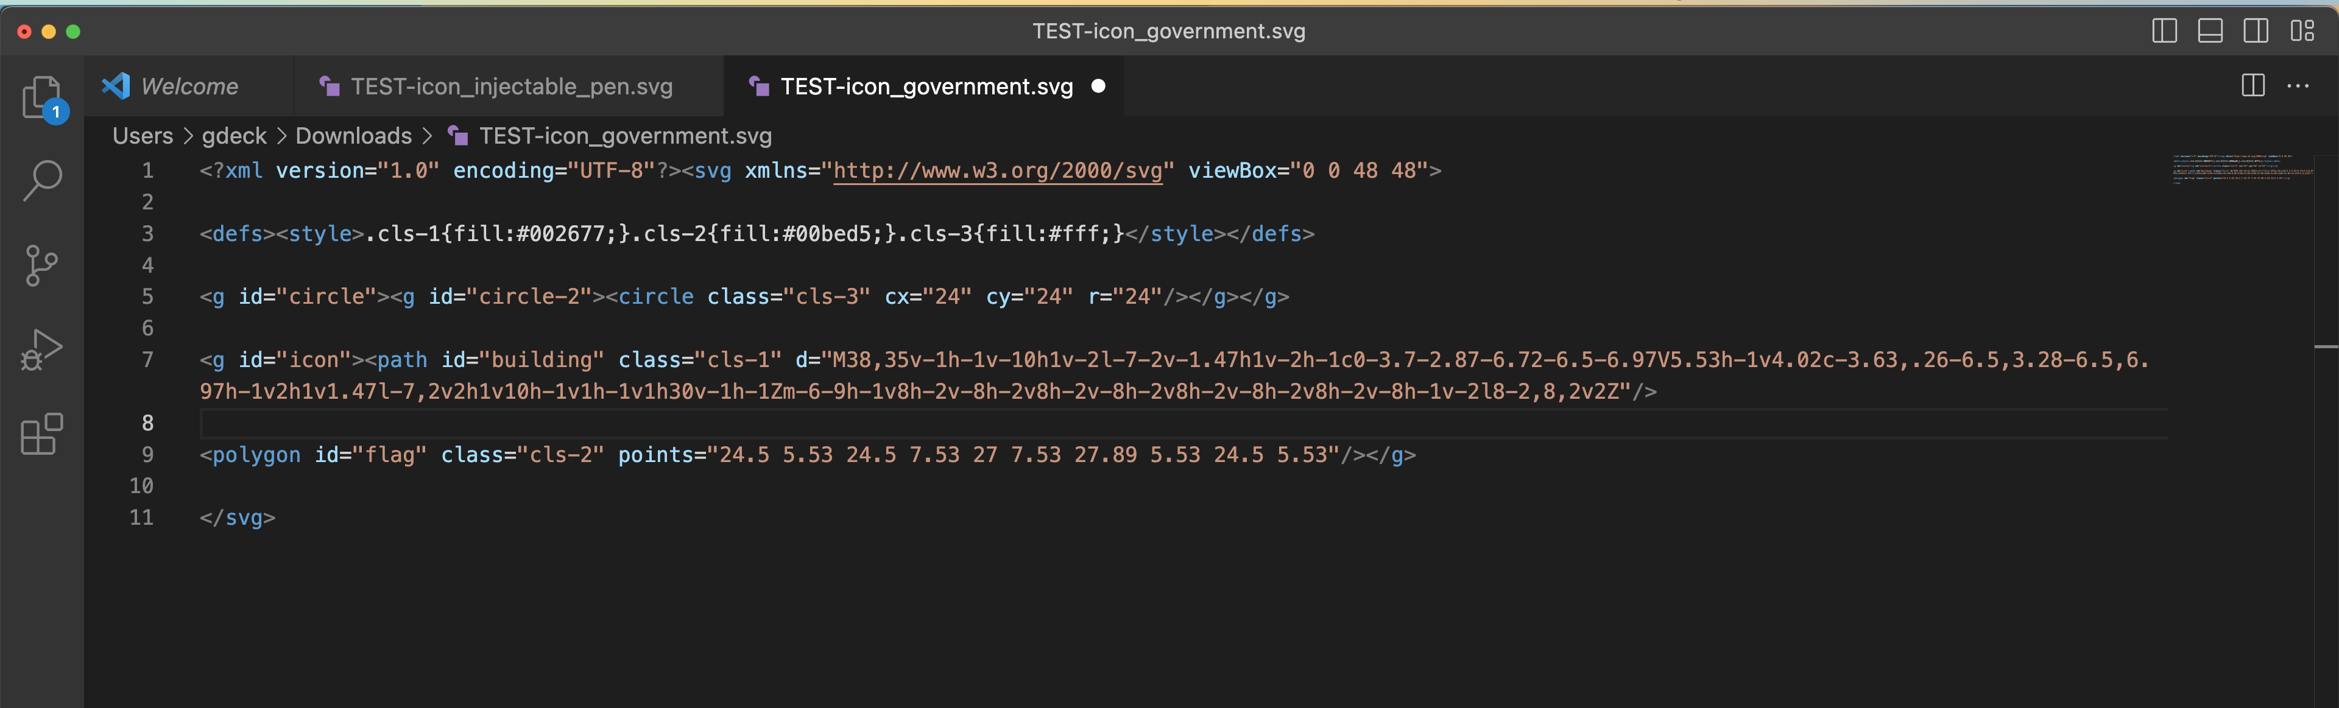
Hard returns
To further help digest and analyze your code, you’ll want to start making some hard returns so you can start understanding the structure of the code.

Slide 20
Confirm size of SVG
Make sure that the viewBox=“0 0 48 48” and the cx=“24” cy=“24 r=24
If it’s just off by a fraction of a pixel, I think it’s ok to just update in the code. If it’s more though, you’ll want to go back to your illustrator file and make adjustments.

Slide 21
Start deleting
Next, we’re going to delete code that illustrator adds in.
Sometimes there’s an id here that can be deleted
This is default illustrator styling we don’t need
<g> tags are not structural to our icons so we can delete
”cls-#” are default adobe classes we can delete

Slide 22
Class-less
This is how it should be looking before you move on to the next step.

Slide 23
4. Add classes to SVG code

Slide 24
Double-check compound layer
Whether you added to your illustrator file or exported separately make sure you have the compound layer included as a separate element for the otc variation, I usually name the layer ”cutout”

Slide 25
Add in AEM stylesheet classes
Now we want to add in our classes from the stylesheet in AEM. First add in the classes and default fill to the <circle> tag, these will always be the same:
<circle class="ot-0 otc-0 ttc-2 ttcw-1" fill="#FFF" cx="24" cy="24" r="24"/>

Slide 26
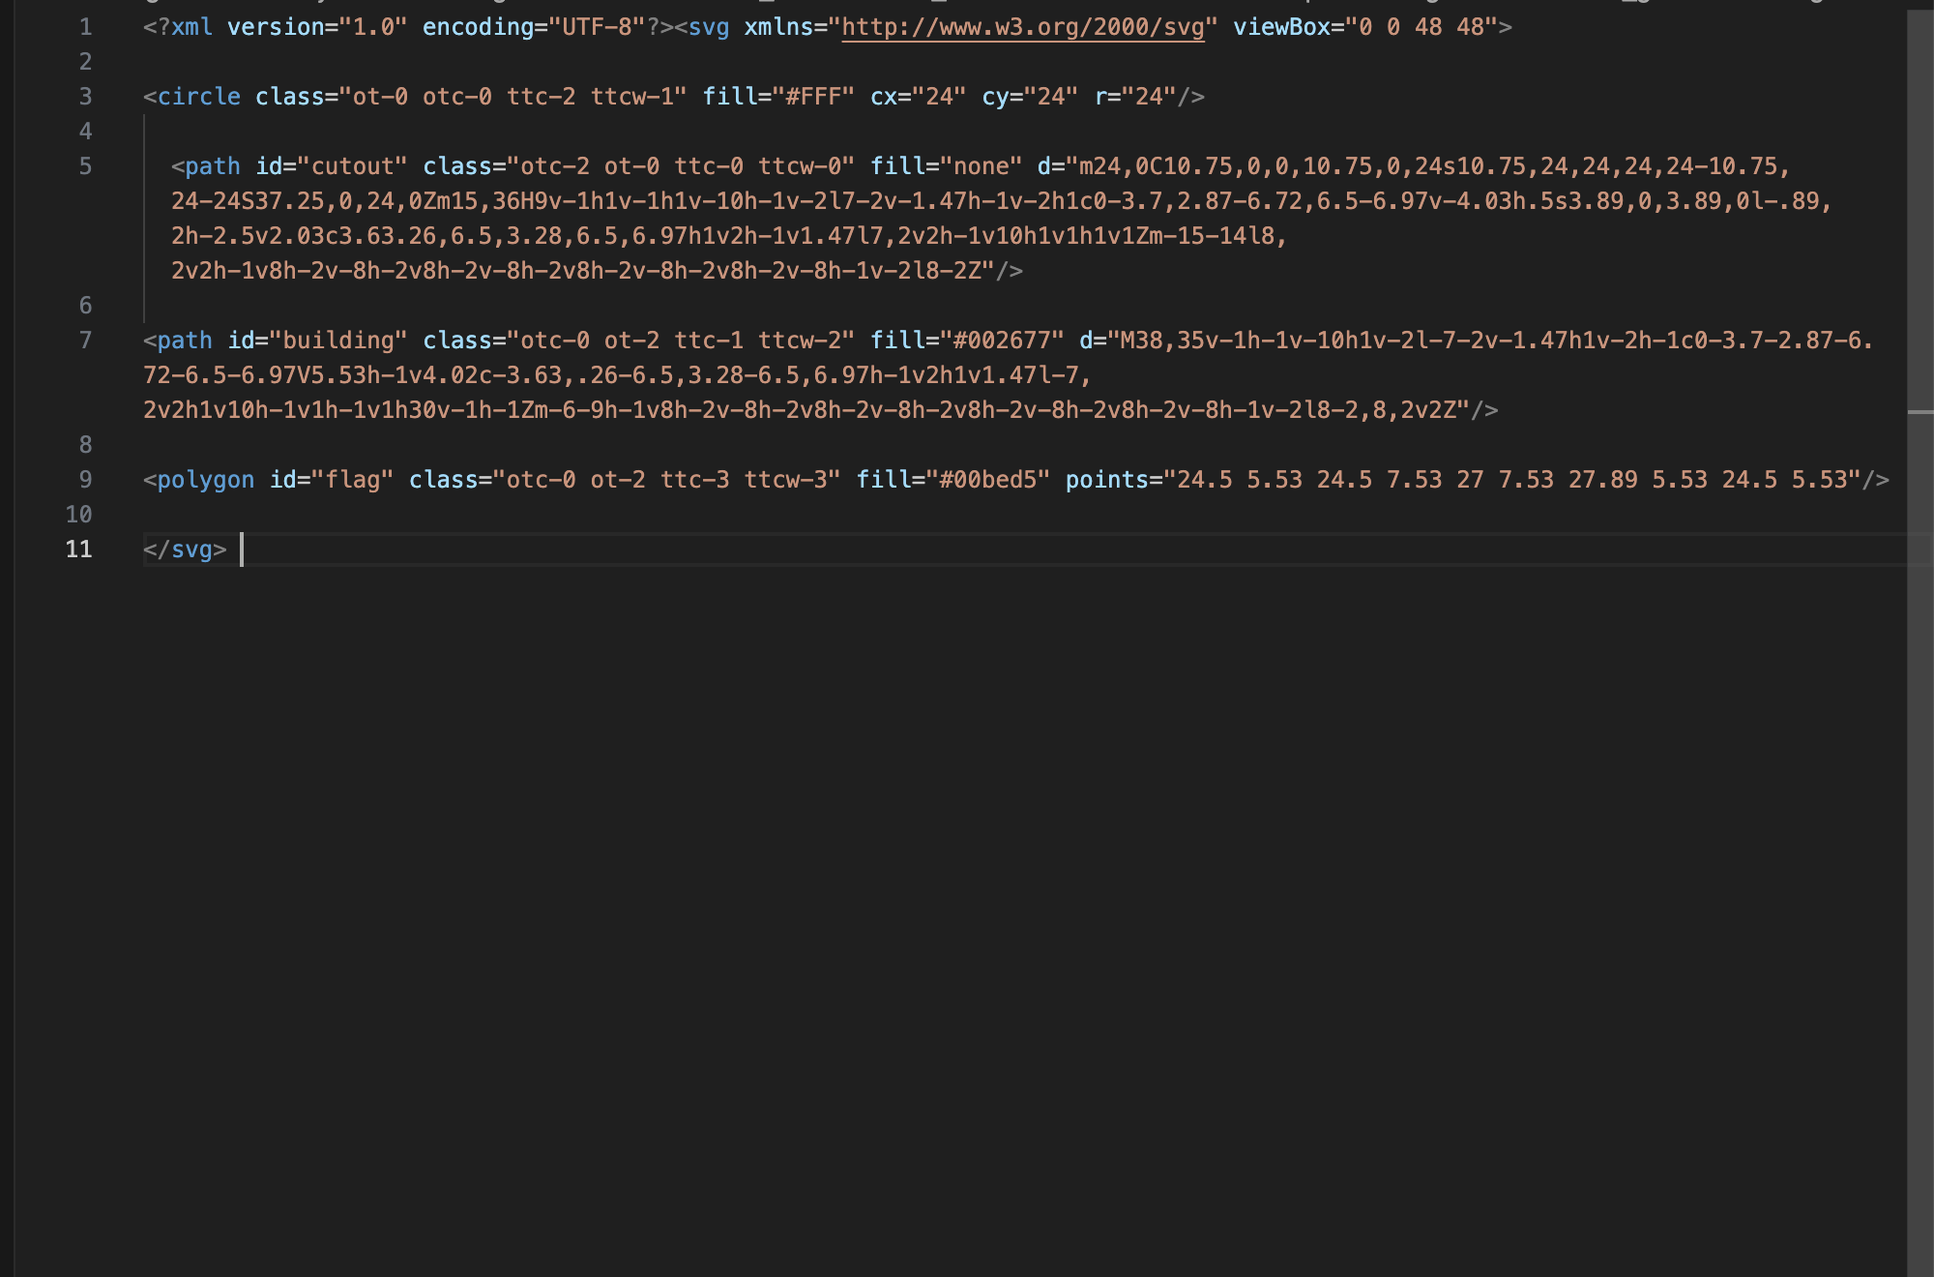
Add in AEM stylesheet classes
Next, walk through each shape and see what color it is for every variation and then repeat for each shape
Otc is handled by the “cutout” path and that’s where its styling should be, everywhere else it should be marked as transparent
ot-2
1-color = ot
Blue = 2
ttc-3
2-color w/ color background = ttc
Teal = 3
ttcw-3
2-color w/ white background = ttcw
Teal = 3

Slide 27
Add in AEM stylesheet classes
If there are structural differences like in the mailbox, I turn on and off the outline flag shape by using 0 as the color identifier to hide it.
Otc is handled by the “cutout” path and that’s where its styling should be, everywhere else it should be marked as transparent
flag class=“ot-0”
flag-outline=“ot-2”
flag class=“ttc-3”
flag-outline class=“ttc-0” (hides the flag outline shape)
flag class=“ttcw-3”
flag-outline class=“ttcw-0” (hides the flag outline shape

Slide 28
Note on order of operations
Unlike in design software the top layer of a shape will be the last layer in the code, because computers read like us and read and draw code from top to bottom.
1. Circle loads first
2. Then the compound shape for the otc variation
3. Then the body of the mailbox
4. Then the opening of the mailbox
5. The full coloring of the flag
6. And then the outline shape of the flag overlays on the top

Slide 29
Optional “at” identifier
There is also an option if a shape has a consistent color throughout all variations to use the all tones or “at” identifier.
For instance, our transplant icon the cross is white in all instances so instead of writing out each individual variation identifier with 1 for the white color like this:
That same idea can be express with just “at-1” to help with more efficient coding:

Slide 30
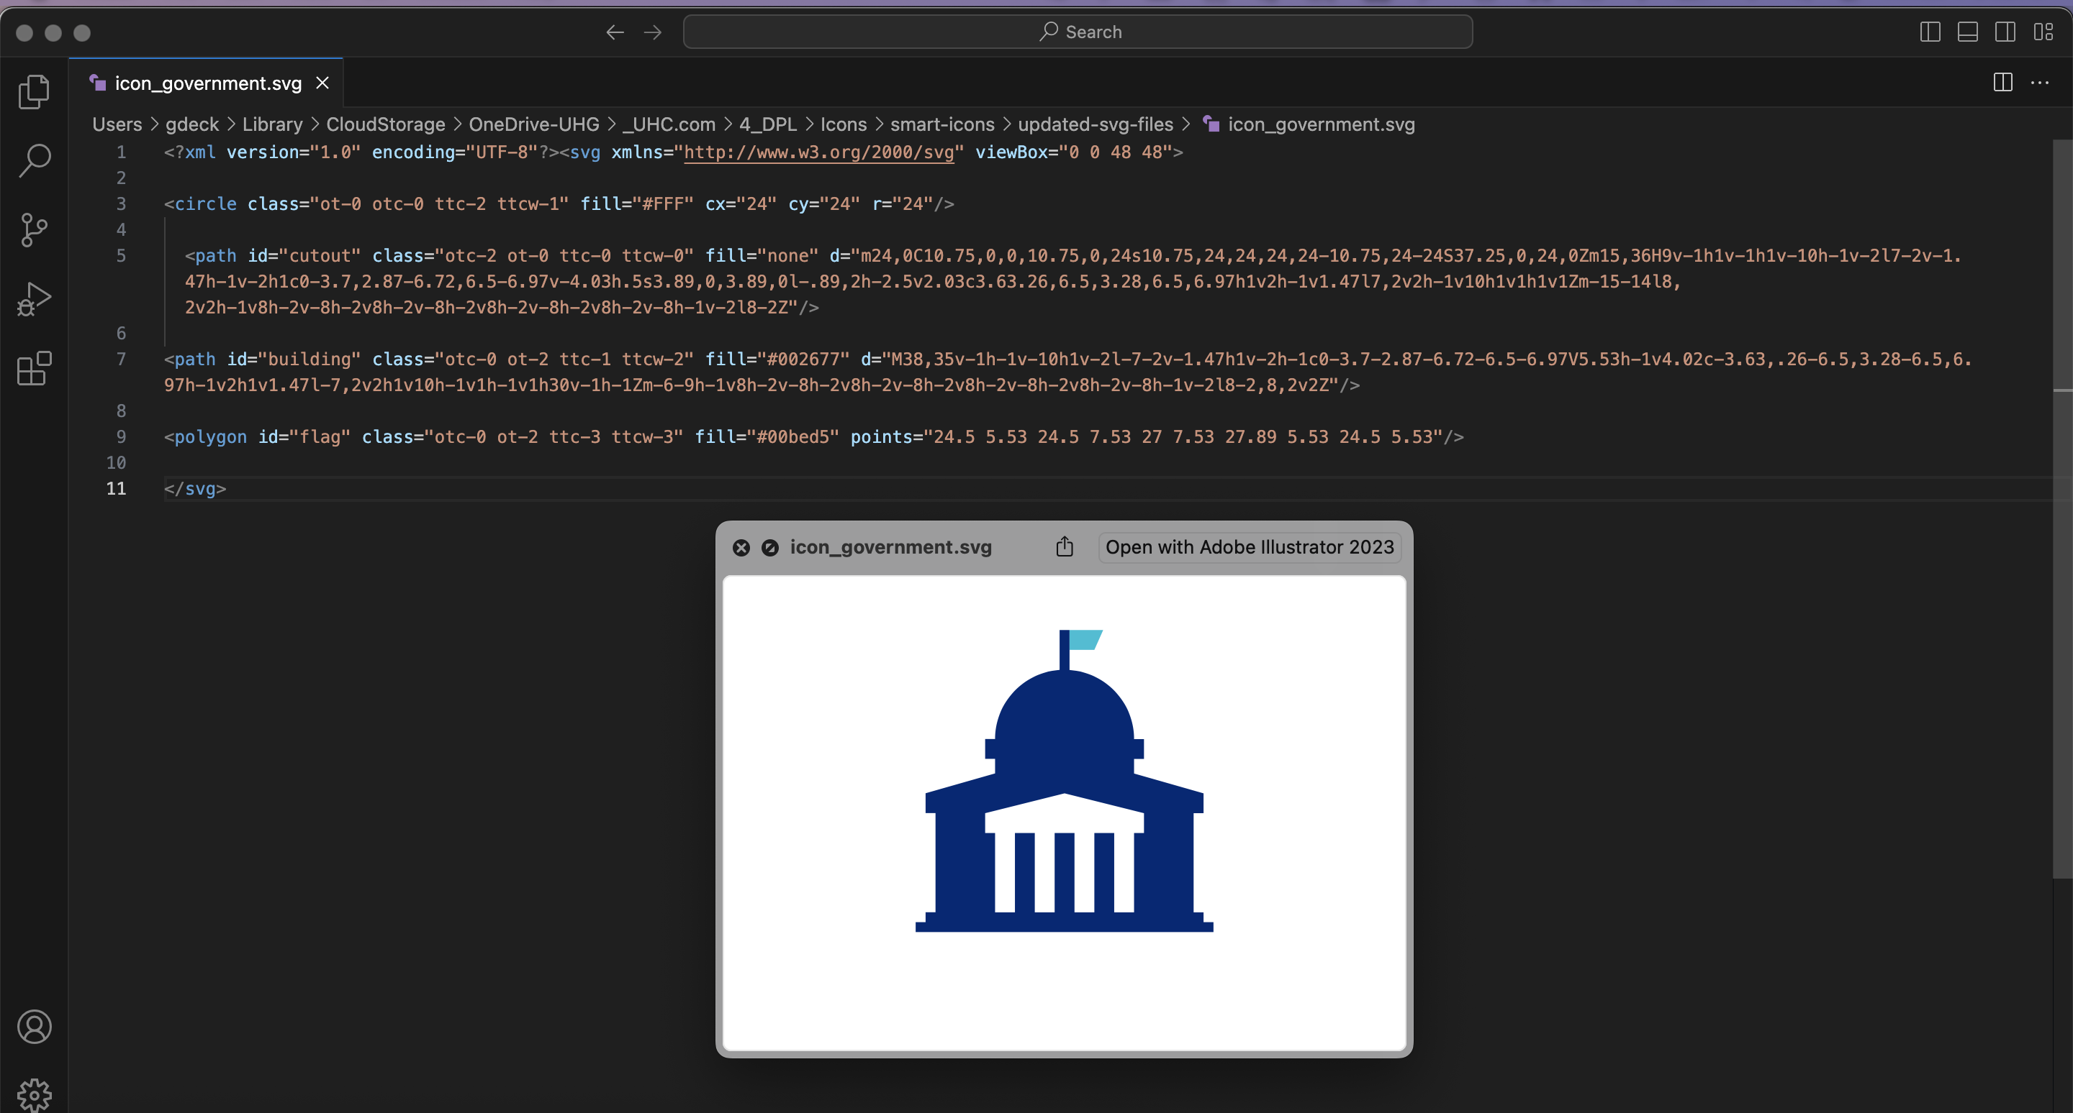
Default fills
I also add default fills to help with preview / default state for viewing in AEM or your desktop. I follow the hex codes from the 2-color white background version of the icon to keep them consistent.

Slide 31
5. Publish SVG in AEM

Slide 32
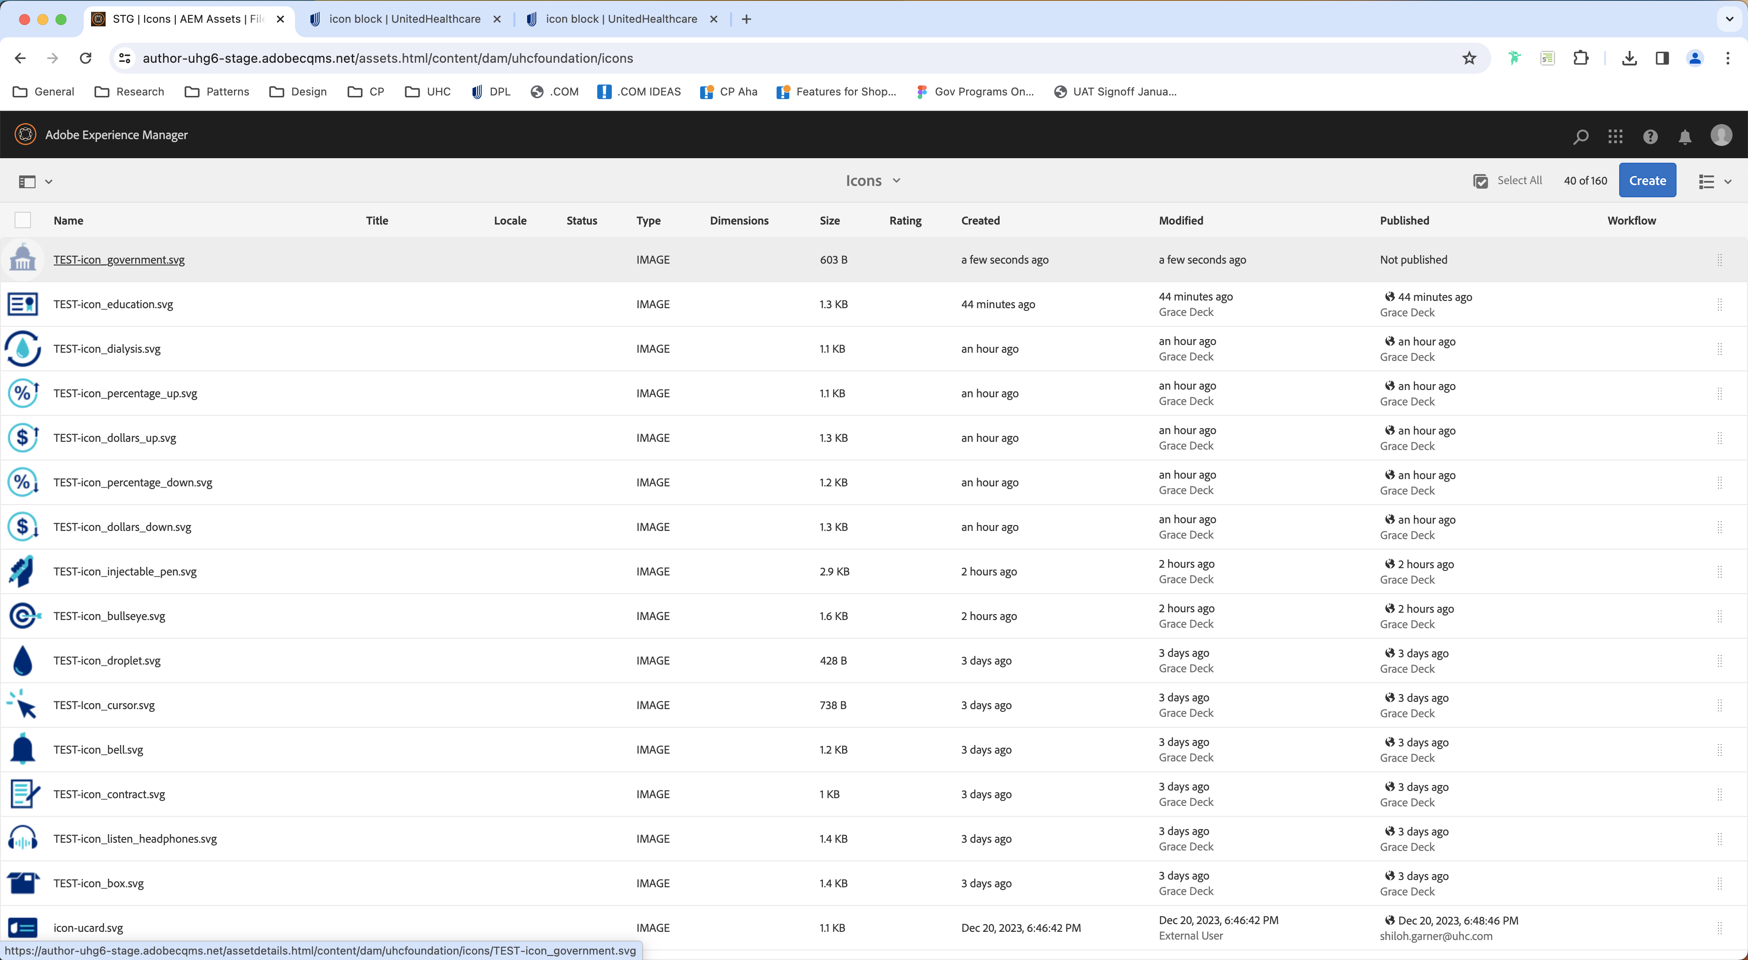
Upload to AEM
The final step in this process is getting the asset uploaded and published to AEM. An author may prefer to do it over the designer, so if you’re the designer good to check with the author you’re working with before you jump ahead. If you are the one responsible for uploading, you’ll want to drag and drop the asset into this folder.

Slide 33
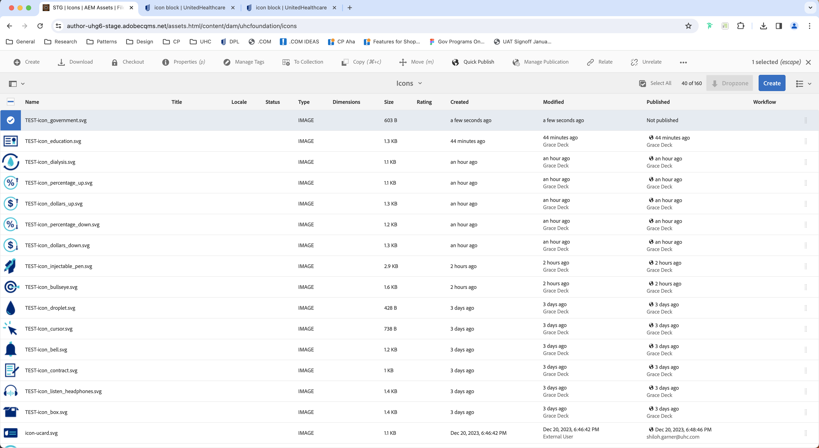
Publish
And then you’ll want to make sure to select the asset you just uploaded and either do a “Quick publish” or “Manage publication” to make sure it’s available in the icon block component. And then you’re done!

Slide 34
AEM CSS Stylesheet (for reference)

Slide 35
AEM CSS style sheet (for reference)
// Icon size
@mixin exact-size($width, $height) {
min-width: $width;
width: $width;
max-width: $width;
min-height: $height;
height: $height;
max-height: $height;
}
.tds-icon {
$extra-small: 48px;
$small: 60px;
$medium: 72px;
$large: 84px;
&--extra-small {
@include exact-size($extra-small, $extra-small);
}
&--small {
@include exact-size($small, $small);
}
&--medium {
@include exact-size($medium, $medium);
}
&--large {
@include exact-size($large, $large);
}
}
// Icon Color section
/* one-tone = ot */
.one-tone .ot-0 {
fill: transparent;
}
.one-tone .ot-1 {
fill: #fff;
}
.one-tone .ot-2 {
fill: #002677;
}
.one-tone-circle .otc-0 {
fill: transparent;
}
.one-tone-circle .otc-1 {
fill: #fff;
}
.one-tone-circle .otc-2 {
fill: #002677;
}
/* two-tone = tt */
// .two-tone .tt-0 {
// fill: transparent;
// }
// .two-tone .tt-1 {
// fill: #fff;
// }
// .two-tone .tt-2 {
// fill: #002677;
// }
// .two-tone .tt-3 {
// fill: #00bed5;
// }
/* circle = c */
.two-tone-circle .ttc-0 {
fill: transparent;
}
.two-tone-circle .ttc-1 {
fill: #fff;
}
.two-tone-circle .ttc-2 {
fill: #002677;
}
.two-tone-circle .ttc-3 {
fill: #00bed5;
}
/* circle = c */
.two-tone-circle-white .ttcw-0 {
fill: transparent;
}
.two-tone-circle-white .ttcw-1 {
fill: #fff;
}
.two-tone-circle-white .ttcw-2 {
fill: #002677;
}
.two-tone-circle-white .ttcw-3 {
fill: #00bed5;
}
/* all tones for speed */
/* keep these defaults easily overridable to reduce number of classes needed*/
.at-0 {
fill: transparent;
}
.at-1 {
fill: #fff;
}
.at-2 {
fill: #002677;
}
.at-3 {
fill: #00bed5;
}

